Slide 1

AFEX Nigeria Update
Capital Markets Committee Meeting – April 2016

Slide 2

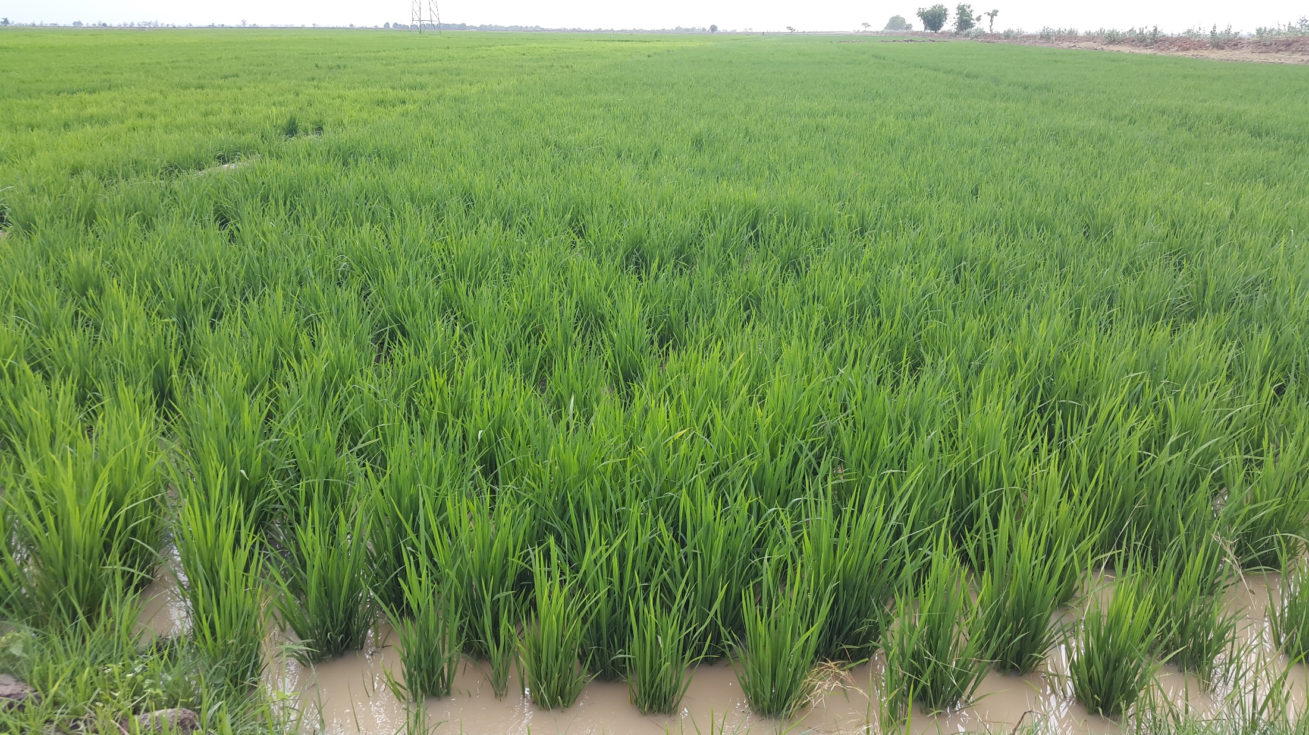
In 2016, AFEX has traded twice the value and volume it traded in 2015.
Year 2015
January – March 2016
Registered Farmers
Registered Farmers
  13,000
  45,000
Farmers Transacted - Grains
Farmers Transacted - Grains
  600 (9 mths)
  5,000 (3 mths)
Closed Trades
Closed Trades
  $5 mill
  (9MTHS)
  $15 mill (3mths)
Grains Handled
Grains Handled
  18,000 MT (9MTHS)
  45,000 MT (3MTHS)
Warehouses : Holding Capacity
Warehouses: Holding Capacity
  4: 16,000MT
  18: 70,000MT

Slide 3

Prepaid Cards as Veritable means of Payment

Slide 4
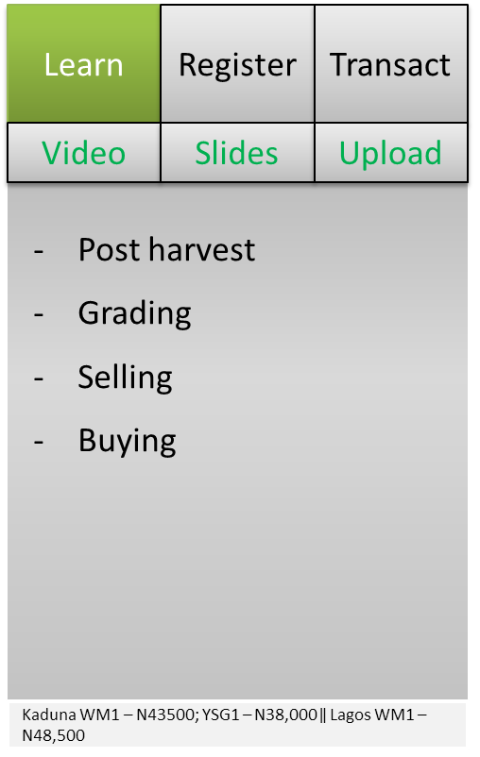
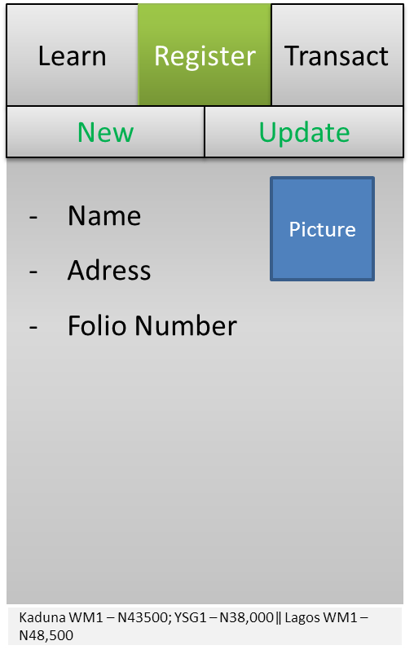
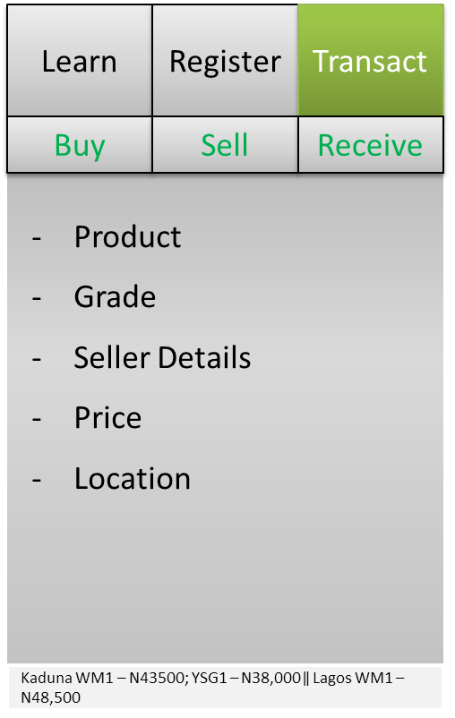
Mobile Application Development

Slide 5
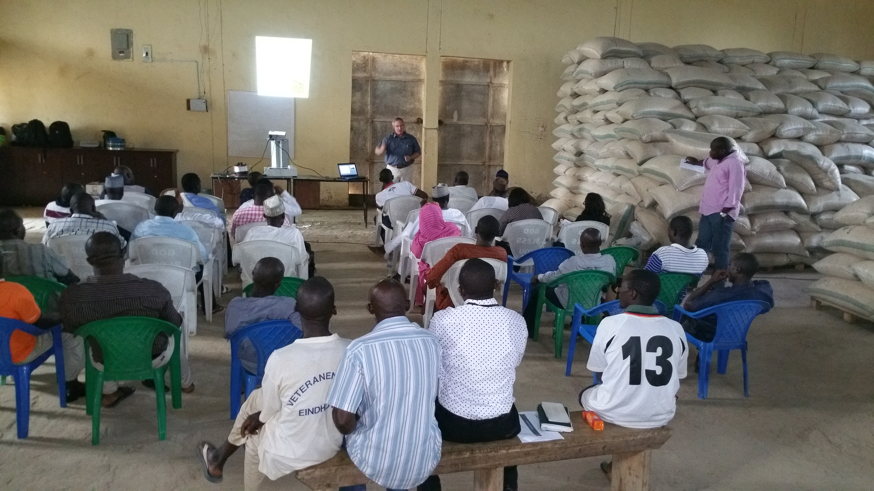
Increased Stakeholder Outreach and Capacity Building

Slide 6
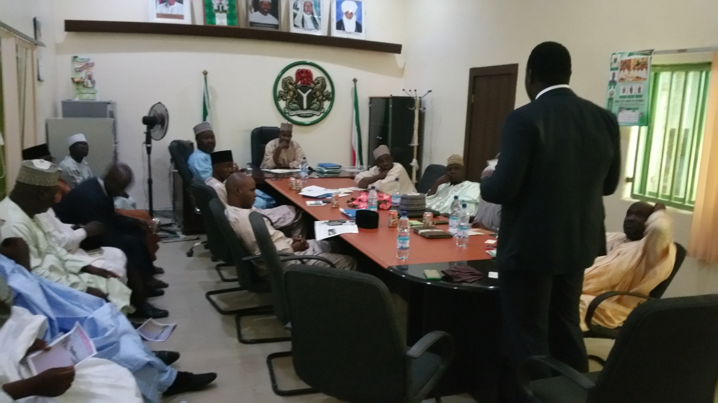
State Level Collaboration on Agric. Development

Slide 7
2016 Season

Slide 8
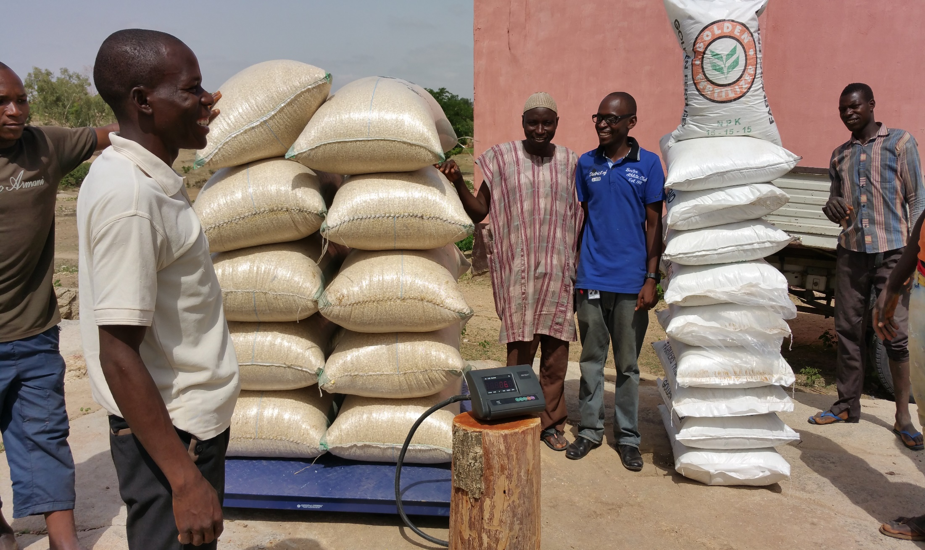
Scale up Grain4Fertilizer Input Program from 2,000 farmers in Year 2015 to 15,000 farmers

Slide 9
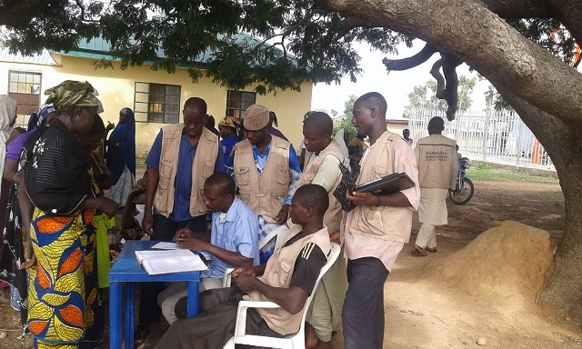

Central Bank Anchor Borrower Scheme for 4,000 Farmers

Slide 10
State Partnership Objectives
1
Improved Access to Input & Education
2
Guaranteed Markets with Price Transparency
3
Price Stabilization – Guaranteed Minimum Price

Slide 11
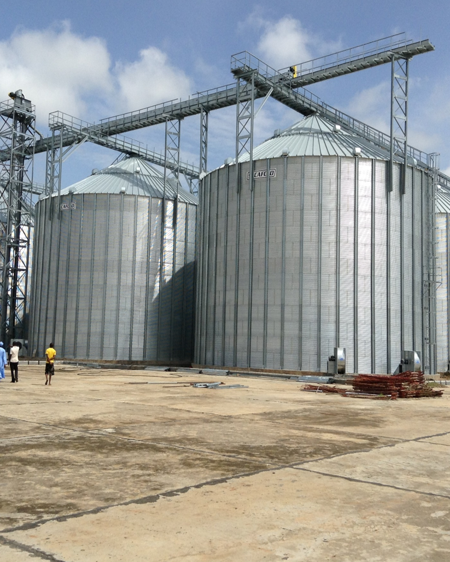

Short to Medium Term Goals
Reach 100,000 smallholder farmers, grow to 225,000 in 3 years
Increase farmer realized revenue per metric ton by 20% of baseline farm-gate price by 2016
Improve bag-to-bulk transaction efficiency - achieve $25 per MT by 2017
FMARD Zamfara Silo Complex

Slide 12
AFEX’s is scaling up its operations to the North Eastern States of Nigeria
Sokoto
Katsina
Zamfara
Jigawa
Yobe
Kano
Borno
Kebbi
Gombe
Kaduna
Bauchi
Kaduna
Niger
Adamwara
Plateau
Key
Kwara
Fct
Plateau
Over 1million MT of grains
Oyo
Nassarawa
Taraba
500,000 – 1million MT of grains
Osun
Ekiti
Kogi
Below 500,000 MT of grains
Ondo
Benue
Ogun
Lagos
Edo
Enugu
Equipped Warehouses
Ebonyi
Anambra
Trading Operations
Delta
Imo
Abia
Cross River
Crops: Cocoa, Groundnut, Guinea Corn, Maize, Millet, Rice, Sesame seed, Soya beans
Bayelsa
Rivers
Akwalbom
Data from National Bureau of Statistics and self estimates

Slide 13
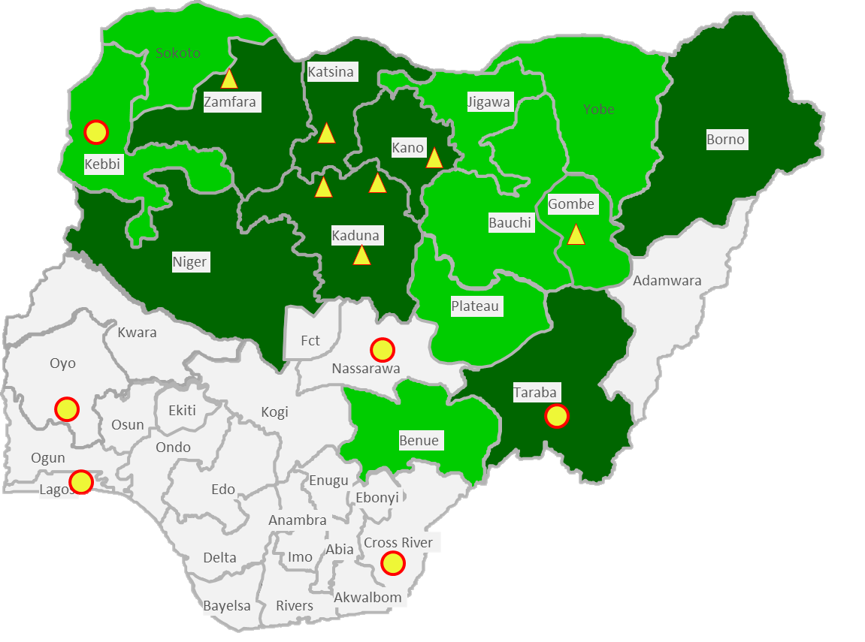
AFEX 2016 Annual Crop and Product Plan
Product Development Plan |  | Products | Volume Targets | Timeline
 |  |  |  | Q3 2015 | Q4 2015 | Q1 2016 | Q2 2016
1.0 | Trading |  | 120,000.00
1.1 | OTC Market | Maize, Sorghum, Soybeans, Paddy Rice | 100,000.00
1.2 | Forward contracts | Maize, Soybeans | 2,500.00
1.3 | Spot Market | Maize, Paddy Rice | 15,000.00
1.4 | Input Retailing | Fertilizer Grain4Fertilizer | 2,500.00
2.0 | Storage | Maize, Sorghum, Soybeans, Paddy Rice | 35,000
3.0 | Warehouse Receipt Financing | Maize, Sorghum, Soybeans, Paddy Rice | 5,000
Products | Total Projected | Outreach | Traders | Market Operations
Maize | 70,000 | 15,000 | 35,000 | 20,000
Rice | 20,000 | 10,000 | 5,000 | 5,000
Soybeans | 10,000 | 6,000 | 2,000 | 2,000
Sorghum | 20,000 | 5,000 | 10,000 | 5,000
 | 120,000 | 36,000 | 52,000 | 32,000

Slide 14


Slide 15


