Slide 1
Debt Capital Market Development (DCMD) Project- Official Launch
Mr. Bolaji Balogun
Chairman, DCMD Project Steering Committee
November 24, 2016

Slide 2
Agenda
Slide 1 | DCM Market Sizing | Page2
2 | The DCMD Project: Nigeria’s Emerging Debt Capital Market | 3
3 | DCMD Project: High Level Timeline | 4
4 | DCMD Project Advocacy Initiatives | 5
5 | DCMD Project Sensitisation & Awareness Campaigns | 6
6 | DCMD Project – Aspirational Impact on Economy | 7
7 | Appendices | 8

Slide 3
Debt Capital Market Sizing
Global Comparison (US$’bn)
 | Nigeria | South Africa | Malaysia | USA | UK
GDP* ($'bn) | 481.07 | 312.80 | 296.22 | 17,947.00 | 2,848.76
Total Debt ($'bn) | 61.82 | 265.34 | 464.49 | 31,406.18 | 4,459.97
Total Debt/GDP | 0.13 | 0.85 | 1.57 | 1.75 | 1.57
Total Debt ($'bn) | 61.82 | 265.34 | 464.49 | 31,406.18 | 4,459.97
Sovereign ($'bn) | 56.55 | 148.79 | 154.05 | 14,344.10 | 1,868.33
Non-Sovereign (Corporates) | 1.89 | 45.32 | 147.58 | 7,526.49 | 1,272.62
Non-Sovereign (Other) | 3.39 | 71.23 | 162.86 | 9,535.59 | 1,319.02
Opportunity for Nigeria?
Nigeria’s DCM must grow substantially (to circa $600bn) to be a multiple of the country’s GDP
Total Non-sovereign debts should also outstrip GDP as shown in other jurisdiction (e.g. Malaysia, USA)
Data as @ November 10, 2016
*GDP figures are as @ Dec. 2015
US$: United States Dollar
Source: Bloomberg

Slide 4
The DCMD Project: Nigeria’s Emerging Debt Capital Market
The 2015 World Economic Forum Global Competitiveness Index listed infrastructure deficit as the most problematic factor for doing business in Nigeria. Access to finance is third on the list.
Globally, there is a growing realisation that vibrant debt capital markets are essential to tackling infrastructural challenges and catalysing socioeconomic development
A well-developed debt capital market will facilitate the realisation of the Federal Government’s Vision 2020 which aims to make Nigeria one of the twenty (20) largest economies in the world by the year 2020
The successful implementation of the Debt Capital Market Development (DCMD) Project will unleash economic growth
and job creation in the country

Slide 5
DCMD Project: High-level Timeline
Periods
 | Q4 2015 | H1 2016 | H2 2016 | 2017 | 2018 | 2019 | 2020
Key Tasks | Rollout Communique
DCMD Workshop
Set-up & Activate DCMD-Project Office
Activate TransCo & SteerCo
Develop DCMD Project Implementation Plan
DCMD Project Launch
Develop DCMD Roadmap
Set-up Committees
& Terms of Reference
Activate Committees/
SubCos
Kick-off SubCo Meetings
Execution of Deliverables by the Implementation Committees
Overall Project Management
Notes
TransCo - Transformation Committee
SteerCo - Steering Committee
Sub-Cos - Sub-Committees

Slide 6
DCMD Project Advocacy Initiatives
S/N | Initiative | Government/Regulatory Institution
1. | Equalisation of the tax exemption incentive for sovereign and non-sovereign bonds, i.e. tax exemptions for both sovereign and non-sovereign bonds to perpetuity Application of tax waiver for Asset-Backed Securities | Ministry of Finance and Federal Inland Revenue Service
2. | Issuance of Interpretative Guidance Notes on Securities Legislation Enforcement of Corporate Governance Code Streamlining of approvals cycle for applications | Securities and Exchange Commission
3. | Removal of tenor limit to allow for extended tenored issuances for State Government bonds, or propose for an extension to ten (10)years | Central Bank of Nigeria
4. | Reduction in cost of perfection of security documents | Corporate Affairs Commission
5. | Removal of regulation limiting participation of insurance companies in the Nigerian DCM | National Insurance Commission
6. | Enhancement of access to finance for SMEs via Securitisation and bundle matching of existing loans | Bank of Industry
7. | Develop appropriate strategies for mobilising the growing buyside through the participation of intermediaries in the infrastructure and housing sectors, as well as SMEs which all have significant financing needs via the capital market | Ministry of Power, Works & Housing, Ministry of Transportation and Nigerian Mortgage Refinance Company
8. | Adoption of a risked-managed approach for Securities Lending by Pension Fund Administrators/Custodians | National Pension Commission
The SteerCo ratified initiatives above will be cascaded to CAMMIC for their consideration

Slide 7
DCMD Project Sensitisation & Awareness Campaigns
S/N | Sub-Committee | Campaign
1. | Regulation Consolidation | Stakeholder Workshop & Sensitisation Campaign on the Use of Trust Structures in Asset-Backed Securities Transactions for Tax Efficiency
2. | Product & Infrastructure Innovation | Stakeholder Roundtable & Awareness Session for Primary Mortgage Institutions on Debt Issuance for Real Estate Funding
3. | Issuers, Investors & Intermediaries Engagement/Education | Rating agencies engagement and deployment of an Awareness Campaign, highlighting the importance of credit ratings for prospective issuers Seminar Sessions for education of issuers on benefits/documentation requirements for accessing the DCM
To Commence in 2017

Slide 8
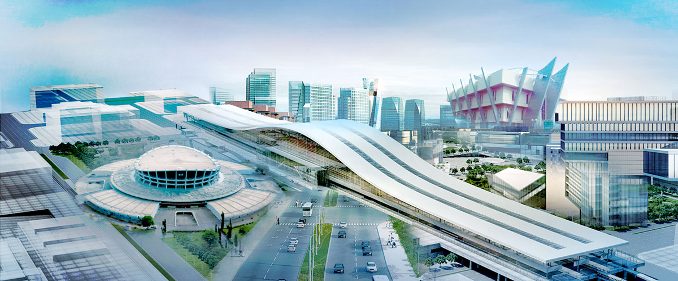
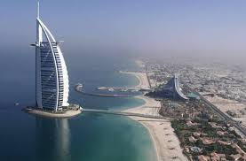
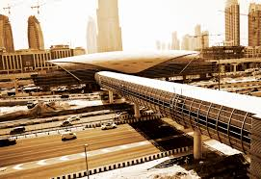
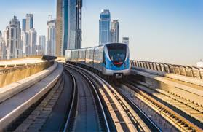
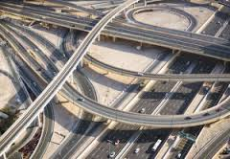
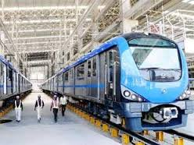
DCMD Project – Aspirational Impact on Economy

Slide 9
Nigerian DCM Aspirational Future State
Parameter | Year |  | Change (%)
 | 2016 | 2020
GDP ($'bn) | 481.1 | 509.9 | 6.0
Total Debt ($bn) | 61.8 | 764.9 | 1,137.0
Sovereign ($'bn) | 56.6 | 382.5 | 576.0
Non Sovereign Debt ($'bn) | 5.3 | 382.5 | 7,143.0
Total Debt/GDP (%) | 12.9 | 150.0 | 1,067
Sovereign/Total Debt (%) | 91.5 | 50.0 | (45)
Non-Sovereign/Total Debt (%) | 8.5 | 50.0 | 485
Secondary Market - Trading Intensity | 0.5 | 12.0 | 2,509
Other Targets:
Participation - Stockbrokers Activity (%) | N/A | 50.0 | ∞
Variety of Securities - Securitised Debts (%) | N/A | 70.0 | ∞

