Slide 1
Technical Committee on National Savings Strategy
Summary Report on Position Paper on a National Savings Strategy
Delivered at the 3rd CMC Meeting
November 24, 2016,
Federal Palace Hotel V.I/Lagos

Slide 2
TC NSS
- Constituted July 18, 2016
- 7-member Committee
- First step towards actualizing recommendations in the Capital Market Master Plan for a national savings strategy
POSITION PAPER
- An 86-page, 6-chapter document which reviews historical data and information on the Nigerian savings-investment culture, the Nigerian financial system, population and economy and the savings and investment strategies of select countries;
- Purpose of the Position Paper is to ascertain the need for a National Savings Strategy in Nigeria and make recommendations on the Strategy;
- Although Nigeria belongs to both commodity rich and emerging economies our national savings rate has been below 20% in the last five years;
- Of the total adult population of 93.5 million, 36.9 million (39.47%) are financially excluded while 11.2 million (11.98%) constitute the informal sector (do not use financial services or products provided by formal institutions);
- To deepen National savings, India; Malaysia; UK; Rwanda; Ghana and Singapore adopt tax-free savings and traditional savings products for successful savings strategies;
- We do recommend a National Savings Scheme to further aid capital accumulation and allocation to boost economic growth and development; To this end our recommendation is that every Nigerian should be opportune to open and have a National Savings Account;
- Success of the Scheme is predicated on – Legislative-backing; No limitations from other laws and regulation; uniform KYC; tax-free savings; extensive financial literacy; and capacity building for regulators and operators to explain products.
- Develop a Position Paper through research on the need for a national savings strategy
- Position paper to be presented to the CMC, Ministry of Finance and Ministry of Budget and National Planning
- Position paper will form the springboard for a National Working Group
- NWG to be constituted to drive the implementation of the recommendations of the Position Paper through a National Working Document
- All stakeholders must be involved in the actualizing of the national savings strategy for holistic application and adoption.

Slide 3
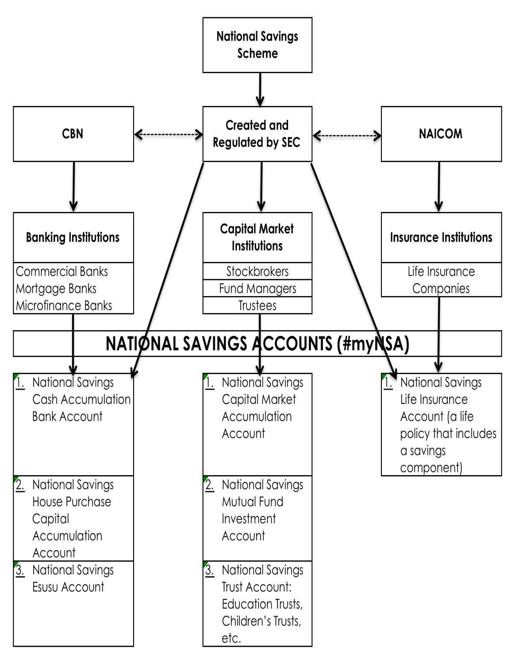
NATIONAL SAVINGS SCHEME NATIONAL SAVINGS ACCOUNT #myNSA
PRODUCT FEATURES
Legislation-backed. Scheme to be regulated by SEC while Accounts to be operated by private sector
Pre-tax or Post-tax
Unique ID Number linked to BVN and TIN
N5 million annual max. limit
N50 million lifetime max. savings indexed to inflation (excludes citizens ≥ 50 years old)
5-year min. tenor. Graduated penalties for withdrawal before tenor ends. Not applicable to interests or dividends gained during the period
Account open with service provider or combination of service providers who are regulated by CBN or SEC or NAICOM
Meant for Medium to long term savings
The use of licensed agents and financial advisers to sell with negotiable fees of 0.25% of contribution
Exemption from all taxes
Migration for one account to another. Liquated equity holdings for purpose of migration exempt from CGT
Custodian to hold assets in accounts operated by non-banking institutions

