Slide 1
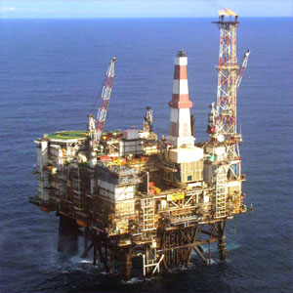
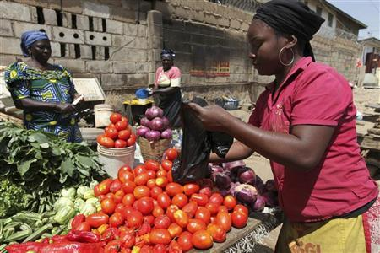
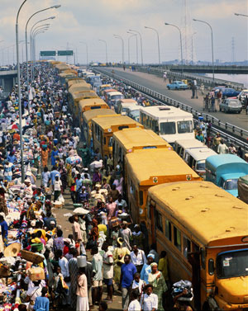
Review of Recent Economic and Financial Developments
Afolabi E. Olowookere, Ph.D.
Presented at the 3rd Capital Market Committee Meeting, Federal Palace Hotel, Lagos on 24th November, 2016
Notes:
Capit

Slide 2
Outline of Presentation
Global Economy
Oil Price and Production
Output and Growth
Prices and Employment
Money Market
Stock Market
Fiscal Position
External Trade and Finance
Determining Factors Going Forward

Slide 3
The Global Economy
Global economic growth has been sluggish but steady.
The IMF (Oct. 2016) reviewed global growth downwards by 0.1% due to
Low growth outlook for advanced economies following Brexit
Weak growth in the US
US Presidential election – future uncertain
Mr. Trump’s pledge to move the economy sent the US stock market up
Trade restrictions – could damage the economy
Trigger the rise of nationalism
Oil?
In UK, the full impact of Brexit is still uncertain
It is still not clear whether UK will leave the European single market or negotiate associate membership
Awaiting Supreme Court judgment on the role of Parliament in the negotiation

Slide 4
The Global Economy (IMF, WEO-Oct.)
Region/Country | 2014 | 2015 | 2016 | 2017
World | 3.40 | 3.20 | 3.10 | 3.40
Advanced Economies | 1.90 | 2.10 | 1.60 | 1.80
Euro Area | 0.90 | 2.00 | 1.70 | 1.50
EMs and Developing | 4.60 | 4.00 | 4.20 | 4.60
Sub-Saharan Africa | 5.10 | 3.40 | 1.40 | 2.90
United States | 2.40 | 2.60 | 1.60 | 2.20
United Kingdom | 3.10 | 2.20 | 1.80 | 1.10
China | 7.30 | 6.90 | 6.60 | 6.20
India | 7.20 | 7.60 | 7.60 | 7.60
Brazil | 0.10 | -3.80 | -3.30 | 0.50
South Africa | 1.60 | 1.30 | 0.10 | 0.08
Nigeria | 6.30 | 2.70 | -1.70 | 0.60
US rates will likely be increased in December - expected due to improved growth prospects.
China growth relatively stable due to policies implemented to support growth
Brazil still in recession but with expectations of less economic, political and policy uncertainty
India continues a strong recovery largely due to effective policy actions
Lower growth for SSA due to the sharp slowdown in some of the largest economies in the region
In Nigeria, the challenges remain:
foreign currency shortages due to lower oil receipts,
low power generation
weak investor confidence

Slide 5
Oil Price and Production
Price of Bonny Light averaged $50.83 in Oct. 2016
An increase of 67.2% this year
Average price still gives room to support budget ($38pb)
But for lowered production
Weak global demand and excess supply have dampened growth
Nigeria production averaged 1,628bpd in October, 2016 (OPEC)
11.9% lower than 1,848bpd in January 2016
Other sources put production as lower
Lower production due to pipeline vandalism and lack of new investment in sector
Nigeria exiting JV cash call arrangement likely to be beneficial
Nigeria exempted from production cuts agreed by OPEC
But, there is still uncertainty about the possibility of the OPEC production cut working

Slide 6
Output and Growth
Nigeria moved into a deeper recession with growth in Q3’16 at -2.24
The industrial sector contracted the most (-12.21%)
Largely due to contraction in Crude Petroleum and Natural Gas sub-sector (-22.01%)
Cement (-6.26%), Food, Beverage and Tobacco (-5.75%) and many other manufacturing activities also contributed
The service sector, which is contributes 50.24% of the country’s GDP, also contracted by -1.17%.
Agriculture sector however grew by 4.54%
Only the Fishing component contracted by -5.59%
Back to the farms!
2015 |  |  |  |  |  | 2016
Sector Growth rates (%) | Q1 | Q2 | Q3 | Q4 | Total | Q1 | Q2 | Q3
Agriculture | 4.7 | 3.49 | 3.46 | 3.48 | 3.72 | 3.09 | 4.53 | 4.54
Industry | -2.53 | -3.31 | -0.13 | -3.04 | -2.24 | -5.49 | -9.53 | -12.2
Services | 7.04 | 4.67 | 3.97 | 3.69 | 4.78 | 0.8 | -1.25 | -1.17
Real Growth Rate | 3.96 | 2.35 | 2.84 | 2.11 | 2.79 | -0.36 | -2.06 | -2.24
Real Non-Oil Growth Rate | 5.59 | 3.46 | 3.05 | 3.14 | 3.75 | -0.18 | -0.38 | 0.03

Slide 7
Prices and Employment
Nigeria inflation increased to 18.3% in October, recording the 9th consecutive month of rise in prices
Increases were recorded in most of the key divisions that make up the CPI
Major increase recorded in the food and core sub-indices
High energy prices and imported inflation
The rise highlights the macroeconomic uncertainty and high cost of living in the country
Unemployment, underemployment have also risen to 13.3% and 19.3% respectively.
Thus, proportion of Nigeria’s labour force working for less than 20hrs a week is 32.6%

Slide 8
Money Market
Short-term interest rates are on the rise
Average OBB rate rose from 2.1% in January to 30.0% in October
During the same period, O/N rate rose from 2.6% to 31.3%. Implications:
High cost of borrowing (govt. and private)
High returns on financial investment
Preference for fixed income instrument
But with high inflation, real return low
MPC maintained the existing monetary policy, leaving the MPR rate at 14%
implying:
Preference for price stability over growth
Trade-off between domestic and foreign investment
Need for complementary fiscal policy

Slide 9
Stock Market
The All-Share Index stood at 27,220.09 points at the end of October 2016
Fell from 28,335.40 recorded in September.
Gained 18.48% from January
Lost 6.71% compared to October 2015
Market capitalization for the same period was N9.4trn
ASI closed at 25,517 yesterday
Market Cap of N8.8tn
Q3 corporate earnings was insipid
Challenging economic environment
Investors negative sentiment
Low foreign inflow
Introduction of Infrastructure Bonds can also deepen market
NSIA, Infracredit, Guarantco, PENCOM, SEC

Slide 10
Fiscal Position
FACC in October fell to N455bn; N559bn was attained in June
Vandalism and maintenance costs
Oil price fluctuations
Low economic activities
Low FACC contributes to States’
Inability to pay salaries
Reduced purchasing power
Federal Government retained revenue in Q3’16 was N934.5 billion
So far 25.7% negative variance this year
Expenditure was N1,235.5 billion
19.6% positive variance this year
Estimated deficit of N1,090.96 billion
98.8% higher than the budgeted for 9 months
 | Q1-15 | Q2-15 | Q3-15 | Q4-15 | Q1-16 | Q2-16 | Q3-16
Retained Revenue (N’b) | 1,027.0 | 538.6 | 1,044.8 | 808.5 | 505.1 | 677.9 | 934.52
Expenditure (N’b) | 1,156.6 | 1,024.5 | 1,190.3 | 1,544.3 | 1,230.3 | 1,136 .9 | 1,235.5
Overall Balance (N’b) | -129.5 | -485.9 | -145.5 | -735.8 | -725.2 | -659.1 | -301.0

Slide 11
External Trade and Finance
Nigeria’s current account has been in the negative since Q4’2015
Stood at –N141.7bn in Q1’16
EIU is projecting current account deficit of –N1,576bn and –N1,607bn for 2016 and 2017 respectively
Nigeria’s external reserve as at the end of October stood at $23.95bn.
Lost 14.9% from January 2016 and 20.5% from October 2015
Dwindling reserves attributed to Nigeria’s inability to meet its crude oil production target
There is about 54% premium between the official (305/$) and parallel (470/$) exchange rates
Market segmentation caused by:
Demand higher than supply
Delayed policy response
Speculation and uncertainty
Efforts to equalise rates
Increased weekly supply to BDCs from $30,000 to $50,000
$7.9bn intervention at the interbank foreign exchange market
Road shows to attract foreign investor
Maintaining MPR at 14%
Investor are cautious
CBN independence
Policy inconsistency
Foreign exchange risk
Poor domestic investment climate

Slide 12
Determining Factors Going Forward
Militancy and insurgency
Corruption fight
Fiscal stance of States
Competitiveness
Investments (Domestic and Foreign)
Infrastructure
Elections – e.g. Edo, Ondo
Oil price
Tax base and rates
Infrastructure
Public Debt
Interest rate
Exchange rate

Slide 13
Thank you

