Slide 1
AFEX Q2 CMC Update
August 2016
Private and confidential and should not be shared with any third party

Slide 2
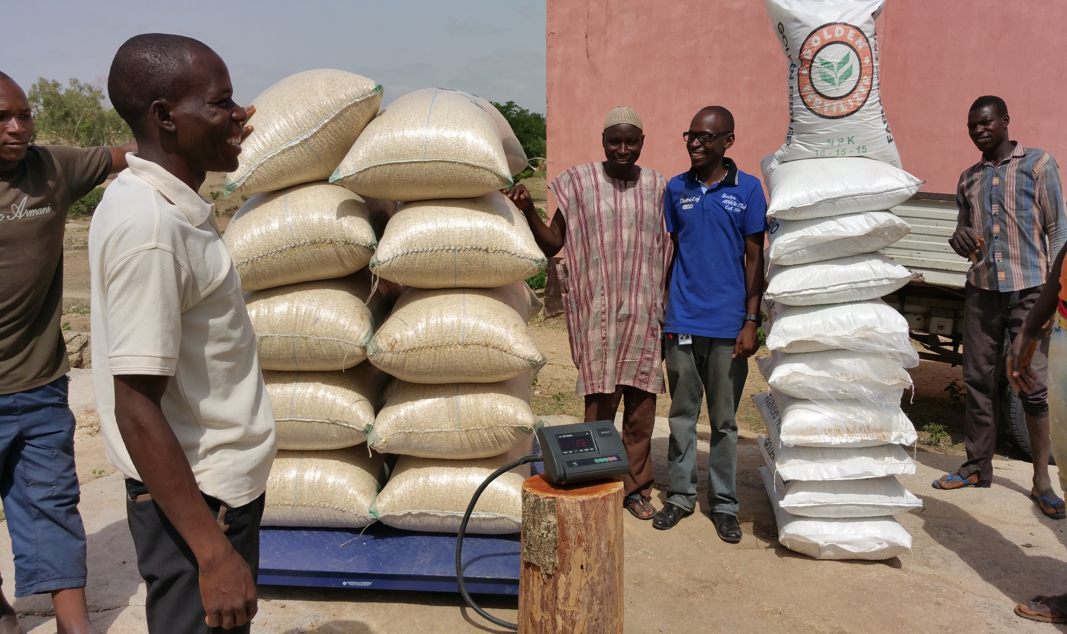
Farmer Exchanging Grains for Fertilizer in a Swap Contract

Slide 3
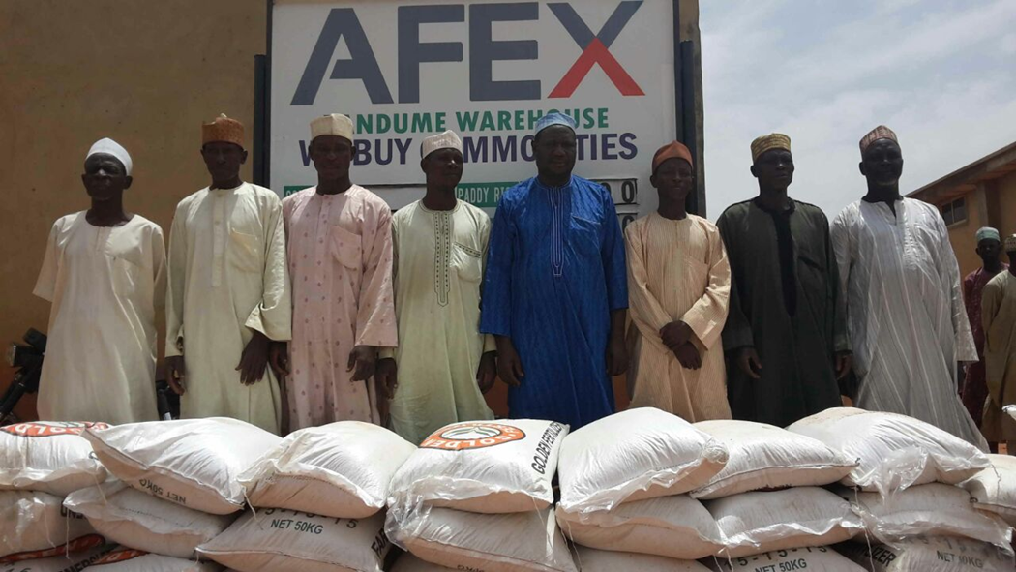

Slide 4
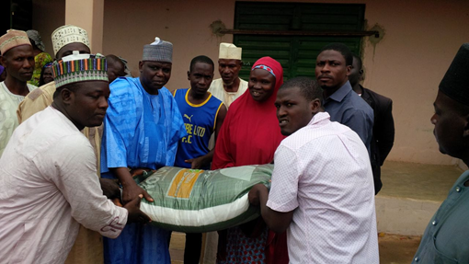

Slide 5
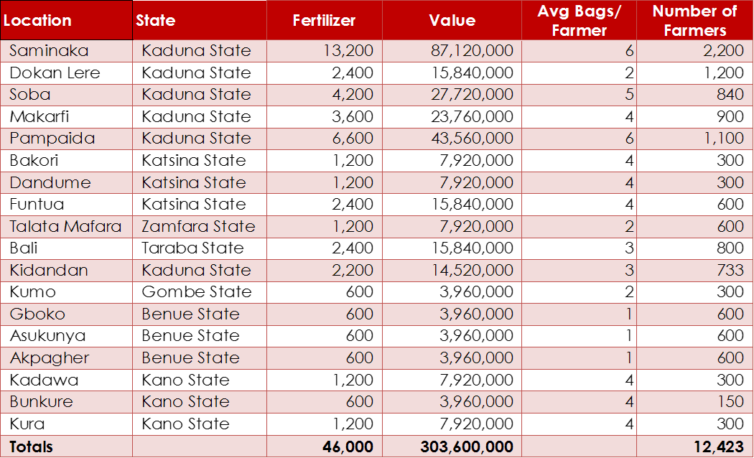

Slide 6
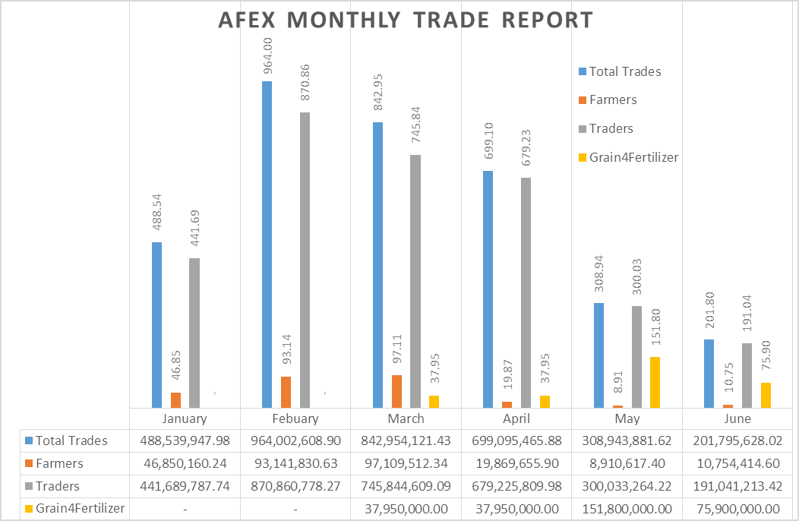

Slide 7
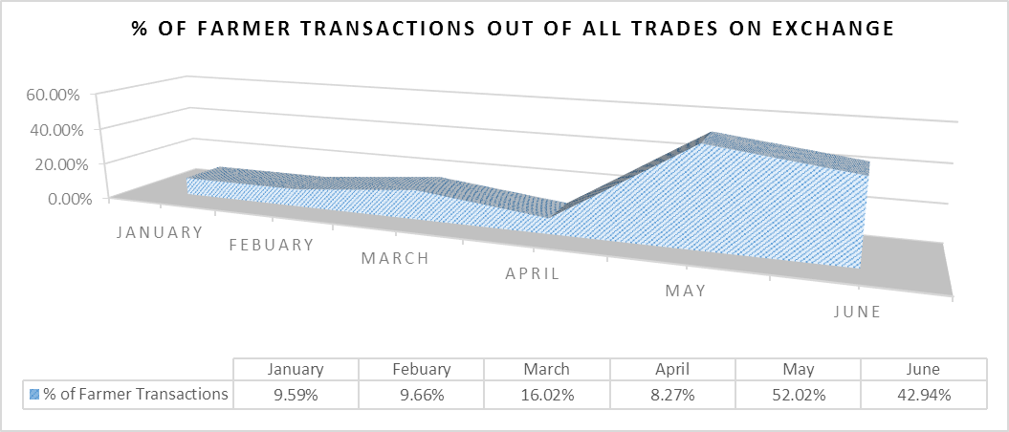

Slide 8
AFEX’s is scaling up its operations to the North Eastern States of Nigeria
Sokoto
Katsina
Zamfara
Jigawa
Yobe
Kano
Borno
Kebbi
Gombe
Kaduna
Bauchi
Kaduna
Niger
Adamwara
Plateau
Key
Kwara
Fct
Plateau
Over 1million MT of grains
Oyo
Nassarawa
Taraba
500,000 – 1million MT of grains
Osun
Ekiti
Kogi
Below 500,000 MT of grains
Ondo
Benue
Ogun
Cocoa Belt
Lagos
Edo
Enugu
Equipped Warehouses
Ebonyi
Anambra
Trading Operations
Delta
Imo
Abia
Cross River
Crops: Cocoa, Groundnut, Guinea Corn, Maize, Millet, Rice, Sesame seed, Soya beans
Bayelsa
Rivers
Akwalbom
Data from National Bureau of Statistics and self estimates

Slide 9
