Slide 1


“PROJECT MERIDIAN”
Presentation to
SEC Nigeria CMC Meeting
August 2016

Slide 2
Contents
Introduction 3
Benefits of the New System 4
CSD Vendor Selection Process 5
TCS Clients 6
New CSD Platform 7
Capital Market Interface – TCS BaNCS 8
Project Implementation Plan 9
Current Status 10
Questions 11

Slide 3




Introduction
In a bid to improve post trade services and to meet the demands of evolving trends and new initiatives in the both the Nigerian and Global Capital Markets, CSCS commissioned “Project Meridian” to acquire and implement a new CSD platform to replace its existing platform
This acquisition has the added benefit of helping CSCS modernize its operations and implement a single integrated application system for all its key business operations
3

Slide 4

Benefits of the New System
Enhanced Technology to improve operational efficiency
Available
High Availability and Improved performance
Efficient
The flexibility to launch new products and initiatives
Flexible
Nigerian Capital Market
Monitor
Enhanced monitoring and investigative capabilities
Asset classes
Automate
Support of a wider array of asset classes
Increased productivity and process automation

Slide 5



CSD Vendor Selection Process
Request For Proposals (RFP)
Vendor Selection
RFPs sent to prospective vendors
Responses received
Vendor Presentations
Proposal Evaluations
Negotiation sessions
Site Visit
TATA Consultancy Services (TCS) selected as the preferred vendor with the approval of the CSCS Board of Directors

Slide 6









TATA Consultancy Services (TCS) Clients
Maroclear, Morocco
Kuwait Clearing Company (KCC)
STRATE, South Africa
CDS, Canada
DTCC, USA
London Clearing House (LCH)
Euroclear Finland
Philippines Depository and Trust Company
Indonesia Commodity and Derivatives Exchange
KELER Ltd., Hungarian CSD

Slide 7
New CSD Platform
  Name of CSD Platform – TCS BaNCS
  The TCS BaNCS platform will provide CSCS with:
    Depository Services
    Clearing & Settlement functions including support for various DVP models
    Integration with Exchanges – NSE, NASD, FMDQ, NCX
    Interface with Market Participants – Registrars, Brokers, Custodians etc.
    Risk & Collateral Management
    Securities Lending and Borrowing (SLB)

Slide 8

Capital Market Interface - TCS BaNCS
Custodians
Settlement Banks
Exchanges
CSCS
TCS BaNCS
Registrars
Brokers

Slide 9
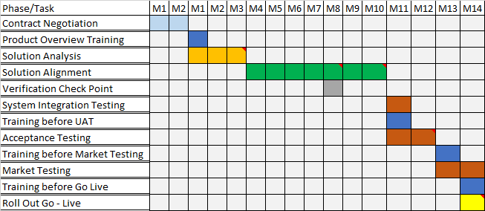
Project Implementation Plan
Project Duration 14 months

Slide 10
Current Status
Project and Change Management
Project Activities | Dec ‘15 | Jan ‘16 | Feb ‘16 | Mar ‘16 | Apr ‘16 | May ‘16 | Jun ‘16 | Jul ‘16 | Aug ‘16 | Sep ‘16 | Oct ‘16 | Nov ‘16 | Dec ‘16 | Jan ‘17 | Feb ‘17
Plan Pre-Mobilisation Product Overview Training
Solution Analysis
Solution Alignment Verification Checkpoints
Testing System Integration Testing User Training (Internal) Acceptance Testing
Training User Training (External) Market Testing Training Before Go-Live
Go Live Preparation
System Build, Data Cleansing and Migration, Preparation for Testing and Training
Project Stage Gates
Go Live
We are here

Slide 11


Questions

Slide 12
Thank you!

