Slide 1


Implementation Strategy for
New Listings Initiatives
Technical Committee Presentation at the CMC Meeting
Tuesday 9th August, 2016

Slide 2
Outline
Review of the Technical Committee Mandate
Implementation Strategy for New Listings Initiatives
Next Steps

Slide 3
Broad Terms of Reference of the Technical Committee
Propose strategies to attract listings from target sectors.
Undertake relevant advocacy
Undertake any other activity that may be relevant to the achievement of this mandate

Slide 4
Draft Mandate of the Technical Committee
The Committee was directed to review the breakdown, assess its practicality, come up with a more robust and practical plan as may be necessary, and articulate implementation strategies for the TOR on the previous slide.
The draft mandate on the right was articulated prior to the constitution of the Committee.

Slide 5
Technical Committee Considerations
Issues Considered
Direct engagement with individual issuers:
  Relatively low impact
  Laborious
  Anti-competition/Conflict of Interest Issues
Imperatives for Attracting New listings:
  Issuers pool
  Breadth of Products/Instruments
  Supportive Rules/Processes
  Incentives
Our Revised Approach
Pre-Implementation Phase:
  Sector/Industry Readiness Assessment
  Identify strategic industry groups
Implementation Phase:
  Engagement with Industry Groups of target Issuer Universe
  Engagement with Relevant MDAs
  Engagement with Market Regulators

Slide 6

Implementation Strategy for New Listings Initiatives
Industry Engagement
Regulator Engagement
MDA Engagement

Slide 7


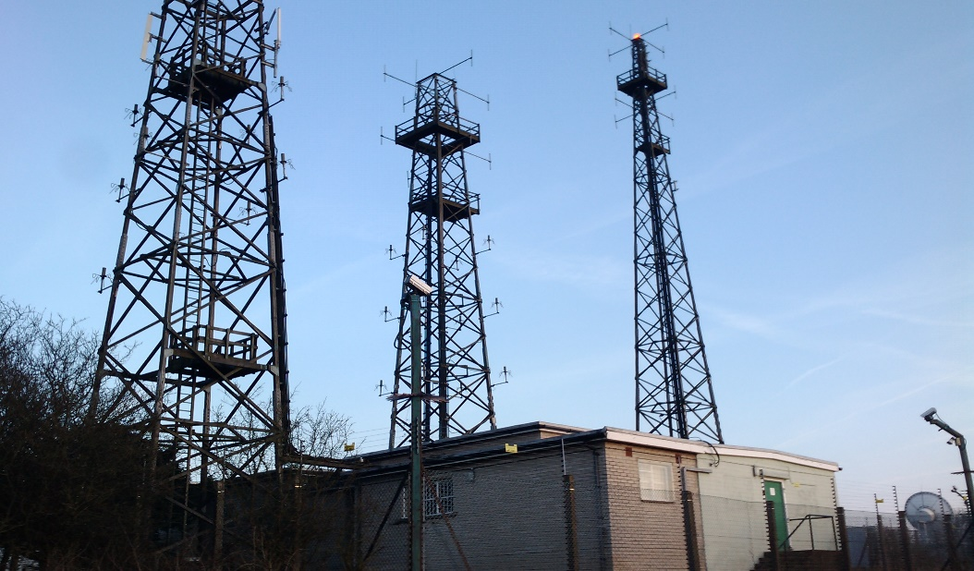

Engagement with Industry Groups
Timeframe: August – December 2016
Strategy:
Engage industry groups to elicit feedback on listing impediments.
Engage with Advisors and Market Regulators to enhance product breadth and practices.
Actions:
Conduct sector/industry readiness assessment.
Identify key strategic Industry Groups/Associations.
Fact finding engagement with target industry groups.
Organize Industry round table: Follow up engagement with target industry groups and companies with Principals of relevant industry regulators.
Secure listing commitment.

Slide 8

Engagement with MDAs
Timeframe: September – October 2016
Strategy: Engage with policy makers and industry regulators to ensure requisite enabling frameworks and incentives to promote listings.
Actions:
Prepare report on listing incentives and impediments based on feedback from industry engagement.
Identify MDAs to be engaged.
Engage MDAs: e.g. FIRS/Ministry of Finance on granting tax incentives.
Follow-up with and get commitment from MDAs on policy changes and incentives.

Slide 9

Engagement with Regulators
Timeframe: September – October 2016
Strategy: Engage relevant regulators to eliminate regulatory speed bumps; ease listings requirements and harmonize processes.
Actions:
Engage the SEC and SRO’s on revision of listing rules and requirements to ensure simplicity, clarity and robustness.
Engagement with the SEC and SRO’s on harmonization of processes to shorten time to market on the different capital market trade points.

Slide 10
Revised Mandate of the Technical Committee
MP Initiative: | Attracting More Listings
Sub-Projects | Tasks | Deliverables | Indicative Timeline
(A) Engagement with Industry Groups | Set up Technical Committee | Technical Committee | 1-Jul-16
 | Identify Industry groups to be sensitized | (i) Create list of prospective industry groups (ii) Create timelines for sensitization | 30-Aug-16
 | Preliminary meeting with each industry group | Get feedback on impediments to listings | 30-Sep-16
 | Follow up meeting with industry groups | Secure Listing commitments | 15-Dec-16
 | High-Value Issuers engagement (e.g. NNPC/ Minister of State for Petroleum) | Listing commitment, structure & timetable | 30-Nov-16
(B) Engagement with MDAs to promote and incentivize listing | Identify MDA's to be engaged | List of MDAs, presentations, timelines and dates. | 30-Aug-16
 | Prepare report on listing incentives. | Prepare report on incentives that will encourage listing | 30-Sep-16
 | Engage FIRS/MoF on granting incentives | Engage on tax incentives to encourage listing | 30-Oct-16
 | Engage BPE | Identification of SOEs to be sold/ privatized SOEs with listing clauses | 1-Sep-16
 | Engage National Council on Privatization(NCP) | Commitment to encourage listing of Privatized Enterprises | 30-Oct-16
 | Engage Ministry of PW&H/NERC | Status of listing clauses for DISCOS & GENCOS | 30-Oct-16
 | Engage Ministry of Communications and Information Technology/NCC | Commitment to TELECOMs listing | 30-Sep-16
(C) Engagement with regulators | Engagement with SEC | (i) Engage SEC on rules impeding issuer listing (ii) Engage SEC on regulatory initiatives that would support listing based on feedback from Industry Groups | 30-Sep-16
 | Engagement with SEC/SRO’s | Engage SEC/SRO’s to fast-track listings by streamlining listing process | 30-Oct-16

Slide 11

Next Steps
Conduct Sector/Industry Readiness Assessment.
Draft list of industry groups for sensitization engagements and identify lead persons for engagement activities.
Identify key decision makers in target firms/industries, MDAs and regulatory bodies.
Develop
  Work plan/activity schedule.
  Requisite reports and position papers.
Commence engagement.

