Slide 1
AFEX Commodities Exchange
CMC Meeting Report
Private and confidential

Slide 2
2017: Year to Date Summary

Slide 3
Price Trends & Opportunities for Investment
It is off importance to study the spread in the price positions as highlighted in structured trade presented by AFEX.
The Commodity Indices presently in development by AFEX along with other sector professionals will provide robust information which will attract more investment for the sector development.

Slide 4
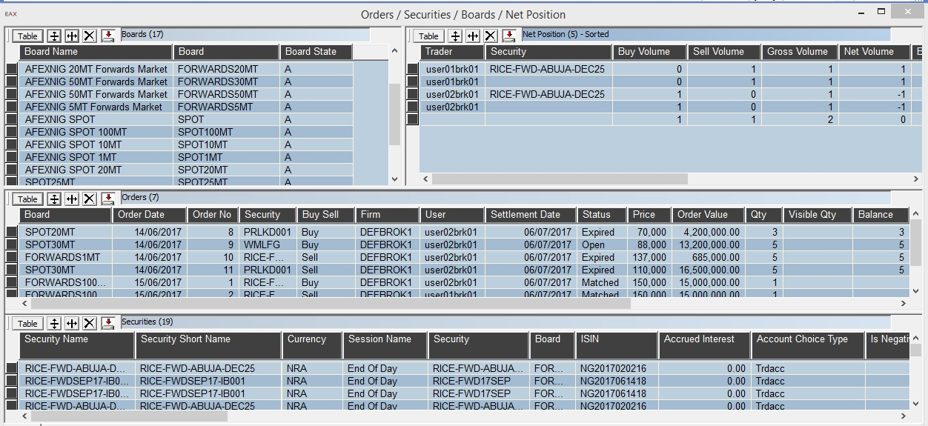
Nasdaq OMX Trading System
In June 2017, AFEX Completed the deployment of the Nasdaq trading system. User Acceptance Testing is currently ongoing as well as the design of the market structure. We hope to go live in 2017 Q4
We have developed trade-able securities and contracts to match the Nigerian environment and its dynamics, with the realities of the physicals markets adapted to meet the needs of the developing commodities and financial sector.

Slide 5
NASDAQ Go-live timeline
Milestone 1
Milestone 8
Aug 10
Q4
Milestone 2
Milestone 3
Milestone 5
Milestone 7
Aug 14
Milestone 4
Sep 1
Sep 29
Aug 18
Aug 23
September
October
August
2017, Q4
In-house Training
Thursday
10/08/17
Monday 14/08/17
UAT: Brokers
Monday
14/08/17
Friday
25/08/17
UAT: Regulators
Monday
21/08/17
Wednesday
23/08/17
UAT: Off-takers
Thursday
24/08/17
Friday
01/09/17
Members Registration
Monday
04/09/17
Friday
29/09/17
Go Live
2017, Q4
Progress
Not Started
Go Live

Slide 6
Next Steps – Commodity Indices
PR: 15,000MT
M: 30,000MT
G:4,000Mt
The ability to efficiently manage a minimum annual volume of 50,000Mt of maize, 20,000Mt of Paddy rice, 20,000Mt of soybean and 4,000Mt of Ginger.
With key consultants we have begun development of the first Maize index due for launch by 4th Qtr 2017. Indices for Soybean and paddy to be deployed from 2nd Qtr. 2018.
Paddy Rice
Sokoto
Maize, Ginger
Katsina
Zamfara
Jigawa
Yobe
Kano
Borno
Kebbi
Maize, Paddy Rice, Soybean
Bauchi
Gombe
Kaduna
Niger
Kaduna
Adamwara
Plateau
Kwara
Fct
Plateau
Oyo
Soybean
Nassarawa
Ekiti
Kogi
Taraba
Osun
Benue
Ogun
Ondo
Lagos
Edo
Enugu
Ebonyi
Anambra
M: 15,000
PR:5,000
SB:5,000
Delta
Imo
Abia
Cross River
Bayelsa
Rivers
Akwalbom
SB:15,000

Slide 7
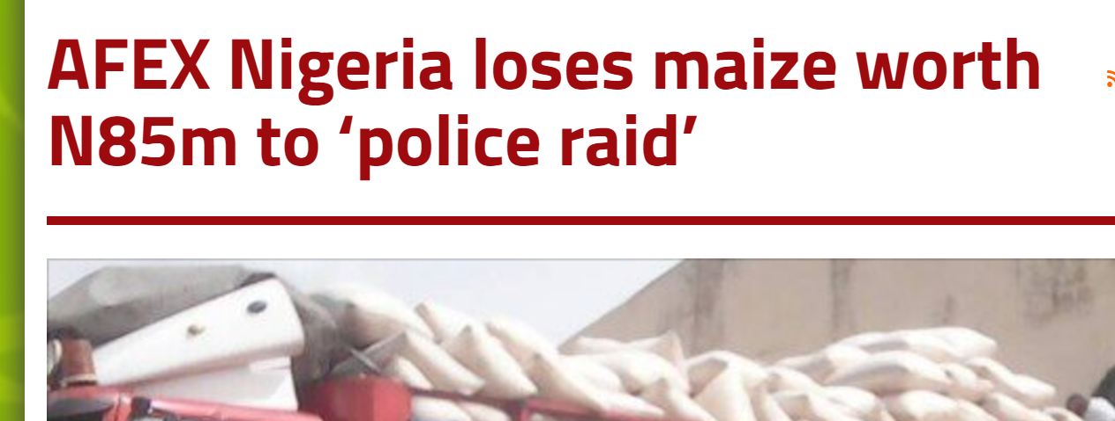
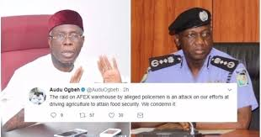
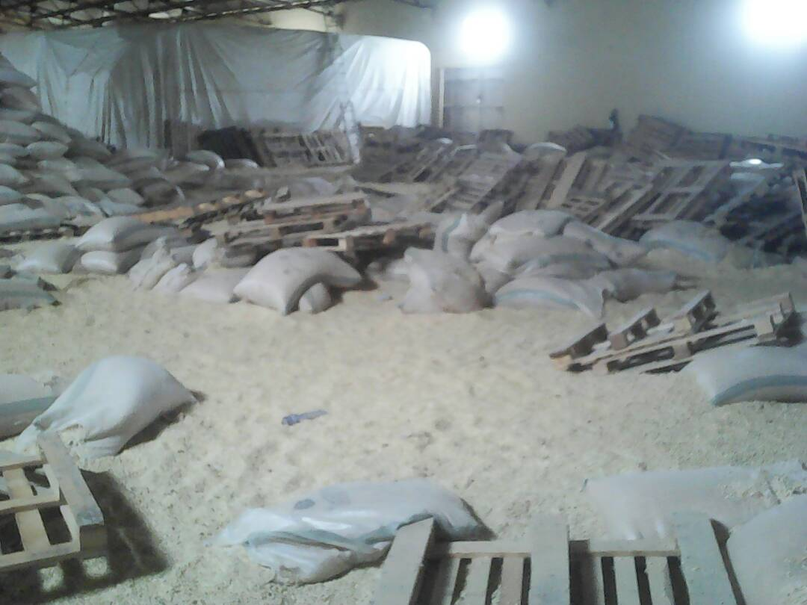
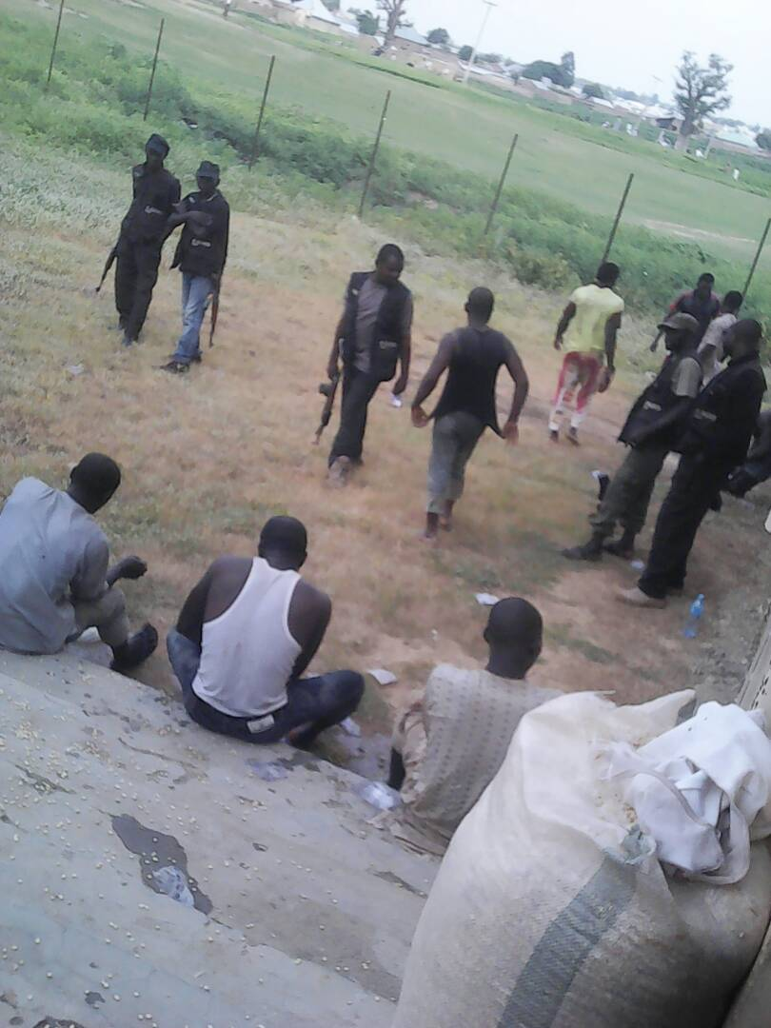
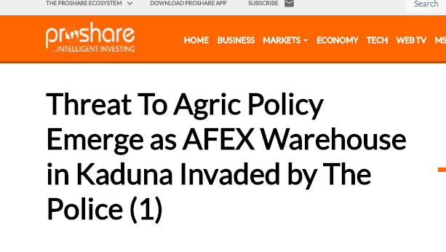
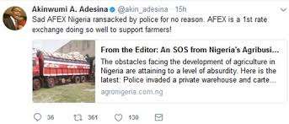
Threat to the Structured Commodities Sector

Slide 8
Thank You
Smallholder post harvest operations, Saoba, Kaduna

