Slide 1
AFEX Commodities Exchange
CMC Meeting Report
Nov 9, 2017
Private and confidential

Slide 2
S/No | Description
1 | Launch of Commodities Trading Platform
2 | NIRSAL Structured Trade Finance
3 | Weekly Price Report
4 | Going Forward

Slide 3
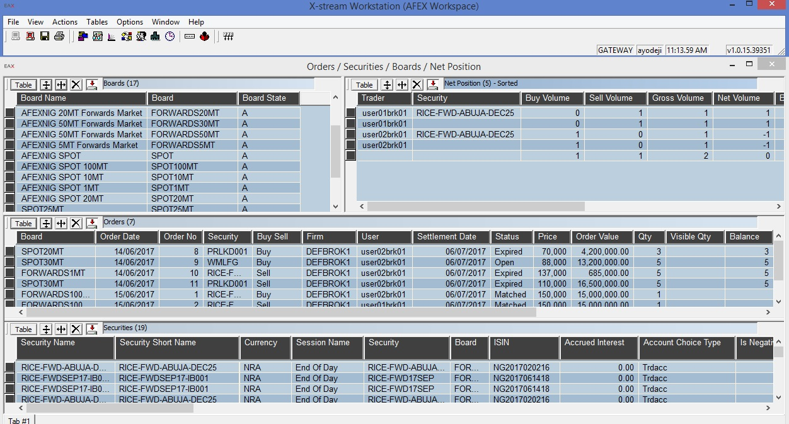
AFEX successfully launched its Nasdaq OMX Trading System on November 1, 2017. 20MT of Paddy Rice was traded on the first day. 590MT has been traded over five days, spanning two commodities

Slide 4
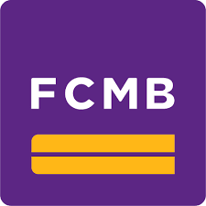
In its drive to unlock capital for players in the agric value chain, AFEX has secured a go-ahead on Structured Trade Financing from NIRSAL
N95.58bn
N19.80bn

Slide 5
AFEX commenced the publication of its weekly price update report. The report covers three commodities Maize, Soybean & Paddy Rice over three region – North West, North East and North Central

Slide 6
Over the next six months, AFEX plans to deepen activities on its trading platform whilst intensifying efforts in market development
Market Development
Onboarding of brokers on the exchange
Indexes Development
Maize, Paddy Rice, Soybean indexes
Food Security Fund
$500mill
Commodities Trading Platform
Weekly Price Update
Structured Trade Finance
Nov 1
Nov 7
Ongoing

Slide 7
Thank You
Smallholder post harvest operations, Saoba, Kaduna

