Slide 1
AFEX – NIRSAL Food security fund
Presentation to Q1 2017 Capital Market Committee
May 2017

Slide 2
NIRSAL AS THE GAME-CHANGER

Slide 3
THE LONG ESTABLISHED AGRIC FINANCING CHALLENGES
Low budgetary allocation to agriculture (2-4% of total budgetary allocation)
Less than 2% of total banks lending goes to agriculture (prior to 2014) when NIRSAL guaranteed some loans
Inadequate funding of research and development
Huge amount of dead capital in unregistered land
Policy summersaults truncating good agricultural interventions
Low productivity due to non-deployment of appropriate technology along the value chain
Unstructured and broken value chains
Lack of good and effective storage facilities
Lack of adequate insurance cover
Scrapping of commodity marketing board

Slide 4
NIRSAL AS THE GAME-CHANGER
The Nigeria Incentive-Based Risk Sharing system for Agricultural Lending (NIRSAL Plc.) was incorporated in 2013 as a USD 500 Million public-private initiative
Wholly owned By the
Central Bank of Nigeria
Designed with the objective of enabling the flow of affordable financing to all players along entire agricultural value chains
The Central Bank of Nigeria
Bankers Committee
Federal Ministry of Agriculture and Rural Development

Slide 5
NIRSAL AS THE GAME-CHANGER (cont’d)
NIRSAL: A Game Changer
Our focus is to raise formal lending to agriculture to about 10% by 2026 through:
Technical Support to key actors along the agricultural value chain
Credit guarantees on loans made to agribusiness investors, farmers, companies and other related actors
Strategic interventions and advice to governments on agricultural matters
Investment support and advisory to value chain actors

Slide 6
NIRSAL AS THE GAME-CHANGER (cont’d)
NIRSAL Core Objectives
Fix the broken agricultural value chains to de-risk agricultural lending
Mobilize finance for Nigerian agribusiness by using credit guarantees to address the risk of default
Provide technical assistance through capacity building across the value chains
Reduce the cost of borrowing

Slide 7
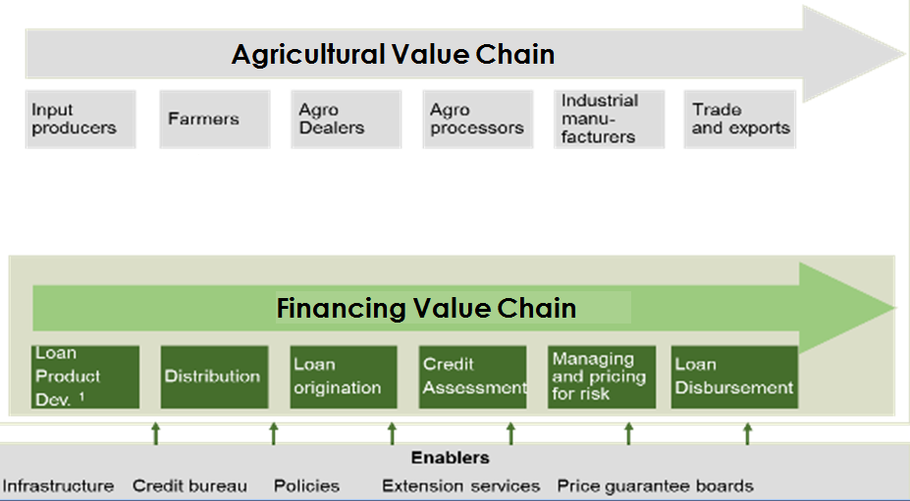
NIRSAL AS THE GAME-CHANGER cont’d
NIRSAL integrates the end-to-end agriculture value chain with agricultural financing value chain
NIRSAL
NIRSAL
NIRSAL
NIRSAL
Financial Institutions
NIRSAL
Agriculture

Slide 8
NIRSAL AS THE GAME-CHANGER cont’d
The integration is driven by NIRSAL’s 5 pillars, particularly the Risk Sharing Pillar and the Technical Assistance pillars . . .
5 –Pillars of NIRSAL
Risk sharing
Facility
Insurance Facility
Technical assistance facility
Agricultural bank rating scheme
Bank incentive mechanism
NIRSAL ($500 million asset are allocated across NIRSAL's five pillars )
Goal
Shares lending risks with banks (e.g. 50% loss incurred)
Link insurance products to the loan provided by the banks to loan bene-ficiaries
Build the capacity of banks, micro-finance institutions
Build capacity of agricultural value chains
Expand financial inclusion
Rate banks according to their effective-ness of lending to agriculture
Targeted incentives that move banks to a long term, strategic position and commitment to agricultural lending
Expand bank lending in agricultural value chains
NIRSAL Objective
De-risk agriculture finance value chain
Build long-term capacity
Institutionalise incentives for agriculture lending

Slide 9
Proposed Food Security Fund (FSF) Structure
Agric Funds and Impact Investors
SWF, DFIs
Foreign Currency Funds
For investors willing to invest in the local agricultural sector. The return on this fund will typically be single digit
Developmental Funds
FCY Funds
Developmental Funds
These are funds from developmental partners, focused on promoting sustainability of the agric value chain. Such partners includes, but not limited to: AfDB, DFID, USAID, BOA, ABP, NIRSAL, e.t.c.
These rates are mostly single digits as they are meant to drive development of the agric value chain
Investment Banks and Financial Institutions
LCY Funds
Capital Market Operators
RIs, PFs
Local Currency Funds
Sourced locally from investors seeking exposure to the agricultural sector.
The anchor of this will principally be members of FMAN, investment houses and retail market in general. The required return on these are usually market determined
Investment Committee
Settlement Fund
Input Financing Programs
Commodity Backed Warrants
Government Strategic Food Reserve
Repos, Forwards & Futures
Commercial Farms
School Feeding Program
Relief Programs
Blue Chip Corporates
SMEs
Credit, Bonds & Loans
These funds will be domiciled in a funds of funds (FoF). Combination of FCY and LCY loans along side developmental funds will drive down the cost of capital. Making funds more accessible to along the value chain
1: This is after considering the volatility in the local currency

