Slide 1
AFEX Commodities Exchange
Q1 2018
Private and confidential and should not be shared with any third party

Slide 2
Recent Developments From Last CMC
2018 Commodities Market Turnover – N’000
 | Jan | Feb | Mar | 2018 Q1
Maize - White | 167,953 | 81,010 | 73,711 | 322,674
Maize - Yellow | 21,914 | 3,237 | 3,946 | 29,097
Paddy Rice - Long Grain | 15,376 | 5,695 | 17,656 | 38,727
Soybean | 19,074 | 32,143 | 6,014 | 57,231
Ginger | 78,213 | 41,304 | 16,698 | 136,215
Total | 302,531 | 163,389 | 118,025 | 583,945
Volume Traded | 2,710 | 1,449 | 1,051 | 5,210
2017
2016
N4.33trn
N4.22trn
Since the launch of the trading system in November of 2017, 2,300MT of commodities has been traded on the system with 7 institutions already onboarded.
Notes:
2017 was a challenging year with the commodities market disrupted by proliferation of importation into the market
Local procurement of commodities increasing with prices stabilizing at the import price

Slide 3
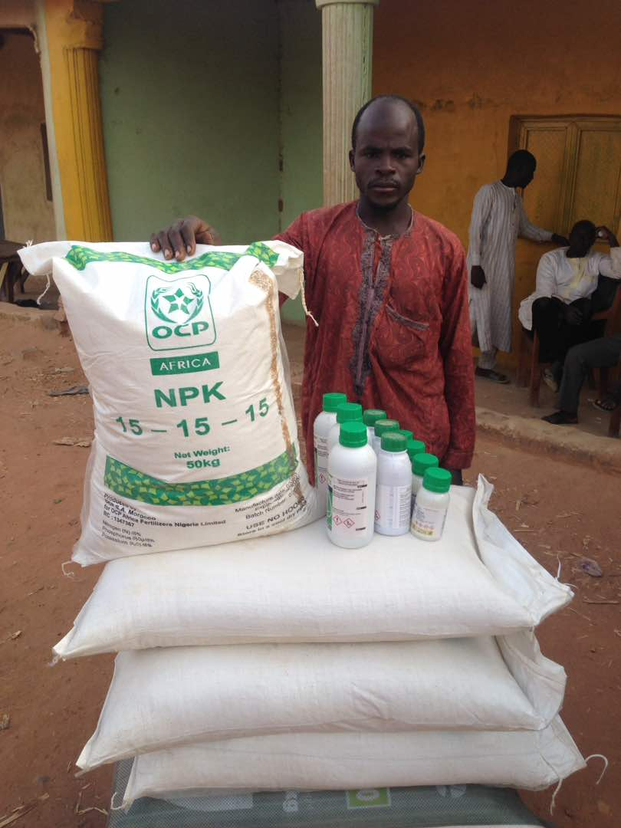
Market Development
2017 FY
Pilot of the Agribooster program with OCP Africa and LAPO MFB
5,000 farmers targeted
Farmers received credit valued at c.N400mm in form of inputs (Fertilizers, CPPs & Seeds)
2018 Q1
Partnered with Dangote Rice Limited to engage 15,000 farmers in the rice belt of the country over 6months
2018 Q2
Engage 50,000 farmers
Signed MoU with major financiers to provide access to quality inputs for farmers
Increase financial inclusion of farmers by enabling access to BVN machines and agency banking in their locations
Partner with key off-takers to aggregate required commodities

Slide 4
Business Development
Link the Commodities Ecosystem with the Financial Ecosystem (Capital Market)
MOU
FMARD
Setup
Storage
Processes,
Commercials
Impact Bond
Trading Platform
Food Security Fund
Capital Market
AFEX Membership Structure
Food Security Fund, Impact Bonds
Agribooster Scale Up
Launch of the Commodity Index
Exchange Traded Commodities
Capital Market Integration – Link Financial and Commodities Ecosystem
Accredited Warehouse Operators
West Africa Operations – Ghana, Liberia, Benin, Niger, Cote-d’vour
Integrated Processes – ERP
Ropo Bond - DFID
Consolidated Business Model,
Input Credit to Farmers
Aggregation Services
Launched Nasdaq Trading Platform
Partnership Agreement with OCP- Africa, NIRSAL, AGRA
Structured Trade Finance
Commenced Export
Registered AFEX, Management Team
Collateral Management Systems
4 operational Warehouses
Corporate Office & Support Team
Processes & Business Assurance
Commercials, Grain4Fertilizer
WAFM - DFID
Signed MOU with FMARD
2013
2014
2015
2016
2017
2018
2019; 2020

Slide 5
Scaling up the supply chain through franchising, memberships, and then building capacity for the exchange business
Commodities Ecosystem
Financial Ecosystem
Soybeans
Asset Backed Securities
Fertilizer
Maize
Sesame Seed
Derivatives
Mechanization
Swaps
Options
Sugar
Cocoa
Forwards
Warehouse Receipt Finance
Hedging
Investments
Paddy Rice
REPOS
Crop Protection Products
Bonds
Futures

