Slide 1
Capital Market Committee (CMC)
Highlights of CSCS Activities – Quarter 1, 2018
Haruna Jalo-Waziri
(MD/CEO)
19th April 2018
©2018 Copy right CSCS Plc. Al Rights Reserved Confidentiality: RED

Slide 2
Outline
CSCS Overview
Market Updates
Market issues
Know-Your-Customer (KYC)
Clearing & Settlement Statistics
Direct Cash Settlement (DCS)
3 Years Strategic Pillars
Technology Update
©2018 Copy right CSCS Plc. Al Rights Reserved 2 | Page

Slide 3
CSCS Overview
CSCS Nigeria Plc. commenced operations on April 14, 1997
CSCS was licensed and being regulated by the Securities & Exchange Commission (SEC)
CSCS is a Financial Market Infrastructure (FMI) that provides Central Securities Depository (CSD) & Sub-registry services for Nigerian Capital Markets
CSCS provides services on the following products: Equities, Debt instruments & Exchange Traded Products, Electronic Warehouse Receipts (e-WR)
Provides electronic Clearing & Settlement services on the principle of Delivery vs. Payment (DVP)
Current CSD rating for CSCS Plc is ‘A’ by Thomas Murray: “Positive” overall risk outlook’’
CSCS
©2018 Copy right CSCS Plc. Al Rights Reserved 3 | Page

Slide 4
Market
©2018 Copy right CSCS Plc. Al Rights Reserved 5 | Page

Slide 5
| Depository, Clearing & Settlement Statistics 1/2
Value Cleared & Settled (in Billion)
Volume Cleared & Settled (in Billion)
Value of share cleared and settled in Q1 2018 for NSE and NASD markets increased by 94% when compared with Q1, 2017 and by 0.73% when compared with Q4, 2017.
Volume of share cleared and settled in Q1 2018 for NSE and NASD markets increased by 121.35% when compared with Q1, 2017 and by 20.96% when compared with Q4, 2017.
©2018 Copy right CSCS Plc. Al Rights Reserved 6 | Page

Slide 6
| Depository, Clearing & Settlement Statistics 2/2
Value Cleared & Settled (in Billion)
Volume Cleared & Settled (in Billion)
0.73%
20.96%
94%
121.35%
Value of share cleared and settled in Q1 2018 for NSE and NASD markets increased by 94% when compared with Q1, 2017 and by 0.73% when compared with Q4, 2017.
Volume of share cleared and settled in Q1 2018 for NSE and NASD markets increased by 121.35% when compared with Q1, 2017 and by 20.96% when compared with Q4, 2017.
©2018 Copy right CSCS Plc. Al Rights Reserved 6 | Page

Slide 7
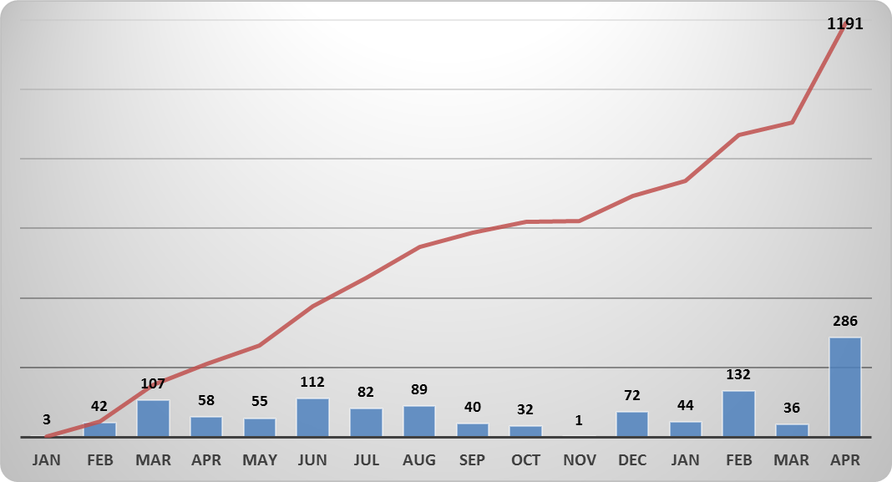
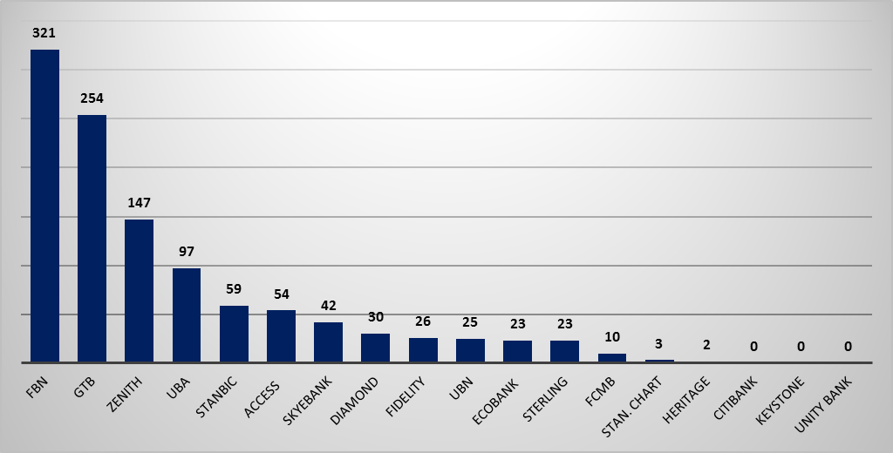
| Update on Direct Cash Settlement (DCS)
1,191 direct cash settlement subscriptions out of 5.1m
This represents only 0.2% of the total number of eligible investors
Only 15 out of 18 Settlement Banks contributed to the DCS initiative
580 Direct Cash settlement requests are waiting for bank confirmation
©2018 Copy right CSCS Plc. Al Rights Reserved 7 | Page

Slide 8
| Capital Market Know-Your-Customer (KYC)
A working committee has been setup to explore the various areas of collaboration between CSCS and NIBSS in recognition of the role both institutions play as market infrastructures towards improving competitiveness, attractiveness, ease of doing business and overall investor experience in the Capital Market, the managements of CSCS and NIBSS have mandated the Committee to continue work on the three (3) areas selected for the first phase of development.
Know-Your-Customer (KYC) Service
Second level validation of customers (especially CSCS walk-in customers)
Confirmation Services
Account number confirmation for Direct Cash Settlement (DCS)
Settlement Services
Brokers bank balance verification
Cash Settlement Notifications
©2018 Copy right CSCS Plc. Al Rights Reserved 8 | Page

Slide 9
| Technology Update
CSCS went live with the TCS BaNCS Market Infrastructure solution on Oct 23 2017.
This business transformation initiative will enable CSCS deepen its service offerings to the Nigerian Capital market via:
Support for various types of account ownership structures
Increased transparency with maker-checker functionality
Improving efficiency in depository, clearing and settlement services
Enhanced SWIFT messaging capabilities
Robust Collateral Management
Support multiple markets and asset classes
©2018 Copy right CSCS Plc. Al Rights Reserved 9 | Page

Slide 10
|Our 3 Years Strategic Pillars
1
Process optimization
Partnership through strategic alliances across businesses and stakeholders
2
4
Customer satisfaction
3
5
Improve technology to deliver corporate goal
Revenue growth
Strategic pillars for the next phase of growth
4 | Page

Slide 11
I Our major milestones & Future Outlook...1/2
2016
2017
November 2016
Full dematerialization of shares certificates
October 2017
Deployed new CSD (Post-trade) platform – Go live
Board & Management put together a 3-year strategic plan
July 2016
ISO Certification
May 2016
Achieved Thomas Murray “A” rating (from A-)
Oct 2016
Co-Sponsored a CCP platform for Nigerian financial market
Jan 2016
Signed MOU with Strate & Kenya CSDs
Nov. 2017
April 2016
Fully complied with CPMI-IOSCO
June 2016
Signed consultancy agreement with Liberia and Gambia CSDs
January 2017
Set up Pension Contributory Management System
February 2016
Commenced biometric enrolment and verification system
August 2016
Deployed E-Gem (Electronic General Meeting) platform
©2018 Copy right CSCS Plc. Al Rights Reserved 10 | Page

Slide 12
I Our major milestones & Future Outlook…2/2
2018
2019
CSCS SRO Responsibility
Onboarding Other Trading Points
Institute STPs across all touch points
Build strategic alliances across businesses and regions
Customer Contact Center
Improve Risk Management
2018
Market Data Analytics Products
Optimise enterprise process performance
Improve Internal/External Communication
Interactive Mobile App Services
CSCS Academy
©2018 Copy right CSCS Plc. Al Rights Reserved 11 | Page

Slide 13
| Document Management Solution (DMS)
This product is designed for the management of your documents (Past, Present & Future) for easy retrieval and safety. It involves conversion of paper documents to electronic format and for the management of records. You can also develop business process and workflow management using this service.
Product Features
Benefits
Efficient preservation of documents
Paperless environment
Easy retrieval of documents
Timely document access & distribution of work flow
Security & access control
Reclamation of space, etc.
Who is this for?
All Corporate entities & Individuals
Stage 1:
Physical Archiving – sorting, classification,
boxing, referencing etc.
Stage 2:
Digitization – classification sorting/indexing preparation – scanning – Digitalization
Stage 3:
Electronic
Document
Management & Workflow Real-time
How to get this service
Contact us @products@cscsnigeriaplc.com or call customer care unit @ 01 9033551
12 | Page

Slide 14
| Market Issues
Real Straight-Through-Process (STP) with Market Participants
Ongoing reconciliation of dematerialised shares with Registrars
Low investors’ Education
Changing technology in global market landscape
©2018 Copy right CSCS Plc. Al Rights Reserved 13 | Page

Slide 15
©2017 Copy right CSCS Plc. Al Rights Reserved 9 | Page

