Slide 1
Financial technology “ fintech”
Presented at the Securities & Exchange Commission 2nd CMC Meeting 2018
9th August 2018

Slide 2
Fintech Defined
Financial Technology, also known as Fintech, is an economic industry composed of companies that use technology to make financial services more efficient. ….Investopedia
Fintech languages; disruption, automation, digitization and simplification
Fintech Offerings - Reduces Costs // Increases Efficiencies // Builds Client Relationships
Facilitates Regulatory Compliance // Offers Security
Fintech Innovation Areas - AI & Robotics // Cloud Technology // Blockchain Technology
Regtech // Financial Inclusion // Payments // Cybersecurity
Insurtech // Open Banking // WealthTech // Captech // EdTech

Slide 3
Fintech Evolution
1950 In February 1950, the Diners Club issued the ﬁrst "general purpose" credit card invented by Frank X. McNamara.
1866 The ﬁrst transatlantic cable was successfully laid, providing infrastructure for ﬁnancial globalization1 .
1838 Samuel Morse demonstrated the electric telegraph system for the ﬁrst time
1967 On 27 June 1967 Barclays in Enﬁeld became home to the world's ﬁrst cash machine. On 30 June 1975, a more sophisticated auto teller machine (ATM), called Barclay Bank was launched.
1971 NASDAQ - National Association of Securities Dealers Automated Quotations - invented electronic trading of securities and the IPO, giving growth companies the opportunity to raise capital from public markets
1981 Michael Bloomberg, created Innovative Market Solutions (IMS) to provide real-time market data, ﬁnancial calculations and other ﬁnancial analytics to Wall Street ﬁrms. The company was renamed Bloomberg L.P. in 1986.
1982 William Porter, created TradePlus, which kickstarted the online brokerage investment revolution and quickly started driving down the cost of online trading. The company was reorganized as E*Trade Group in 1994.
2009 Version 0.1 of Bitcoin SW is released. It includes a Bitcoin generation system that would create a total of 21 million Bitcoins through the year 2040.
2013 Google introduced Google Wallet , which allowed users to make purchases from their mobile phones using NFC technology. Apple similarly launched Apple Pay in 2014

Slide 4
Fintech Value Propositions in Capital Market
Fintechs : Friends or Foes

Slide 5
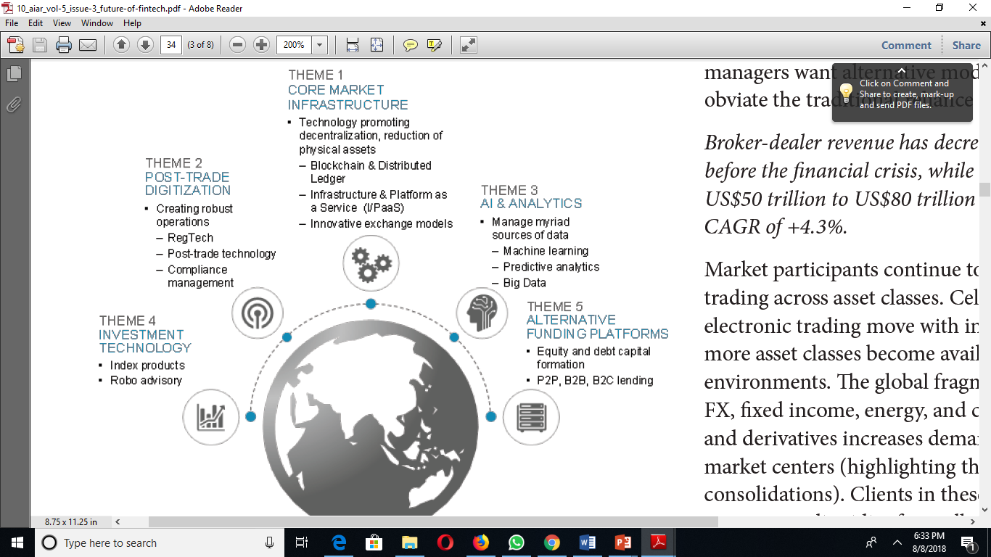
Aiding Capital Market with Fintech
Fintech-led innovation can be found in all five
major parts of the CMI value chain
Access to capital—creating innovative ways
to reach and serve issuers and investors, and
broadening the range of asset classes offered
 Trade execution—gaining new efficiencies
 Post-trade services—bringing simplification,
automation, and improved security to
incumbents’ operations
 Data, analytics, and information
services—developing new techniques to
mine and interpret data to its full potential
 Operations and technology—creating
greater cost efficiency, lower latency, and
reduced operational risk
Future of Fintech in Capital Market by Brad J. Brailey

Slide 6
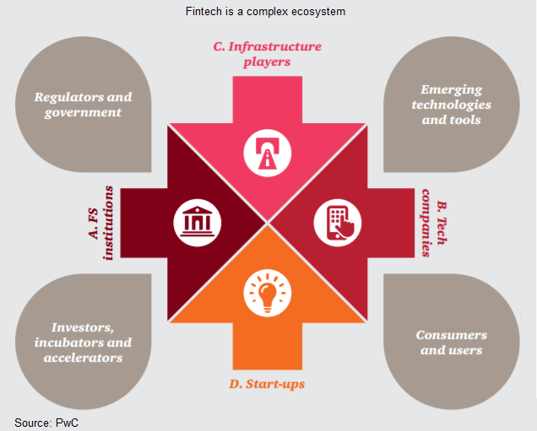
Key Driver of Fintech Benefits
FinTech is shaping financial services from the outside in..
FinTech is driving the future of financial services and increasing customer satisfaction…
The Future of FinTech and Financial Services Delivery
For the Regulator – Its REGTECH:
The term RegTech refers to a set of companies and solutions that marry innovative technology and regulation to address regulatory requirements across industries, including financial services.

Slide 7
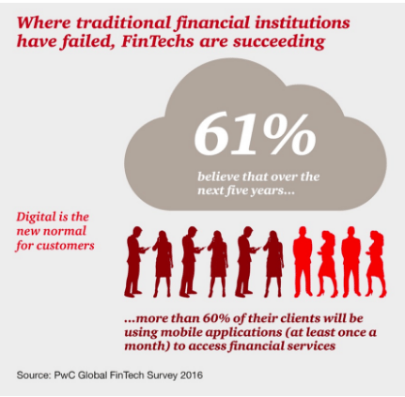
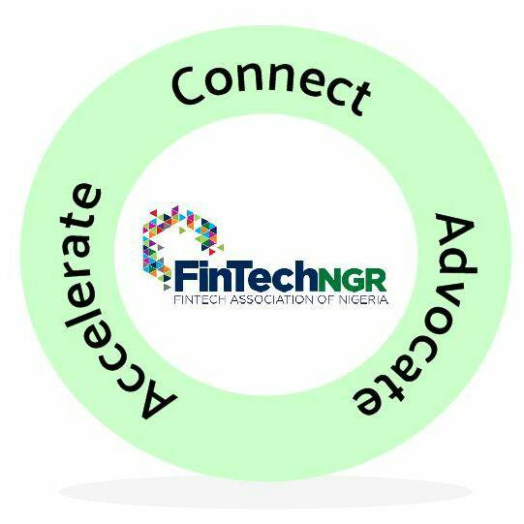
Collaboration & Leadership By Regulator To Deliver Fintech Benefits
C
O
L
L
A
B
O
R
A
T
I
O
N
FintechNGR provides a collaborative platform for incumbents and fintechs across the board
Collaboration on policy formulation
Knowledge events and empowerment : Masterclass series for Capital Market Executives
Collaboration with CMC to draw a Tech-Driven Capital Market Roadmap for Nigeria
Seed Funding for Innovative Startups; Startup incubation & acceleration hub, Captech Startup fare

Slide 8
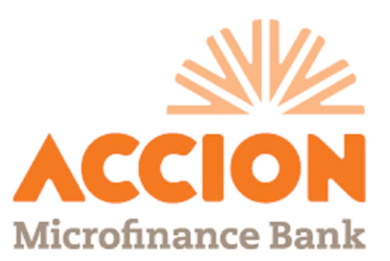
The Strength of FintecNGR as Thought Leader
Diverse Membership Base
Global Affiliations – Member of Global Fintech Hubs Federation (seventy member institutions, it serves as a vehicle to access global best practices in Fintech), leading formation of African Fintech Network to achieve market access for Fintech products and advance regional/cross border policy regime amongst other things in the continent.
Global Reputation – Recently consulted by IMF, DFID on financial inclusion and open banking initiatives in Nigeria
Strong Local Presence – Participated in CBN FSS2020 Strategy Retreat, working with NAICOM & insurance bodies on driving insurance inclusion with technology, working with the National Assembly on Fintech Regulation Bill amongst others
BANKS, ICT & FSPs
LEGAL, CONSULTING & VCs
MEDIA, EDUCATION & START-UPS
Risk Analyst

Slide 9
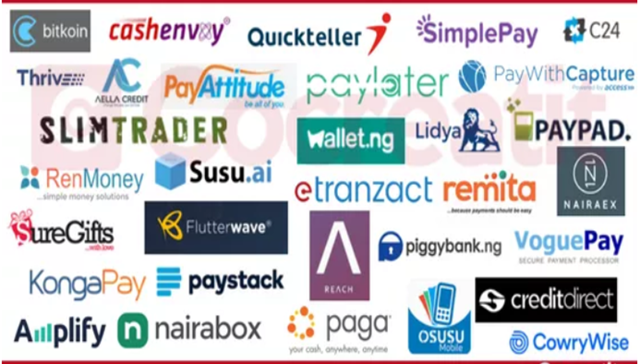
Overview of the Fintech Ecosystem in Nigeria
Platforms thriving in Payments:
Amplify
Cash Envoy
eTranzact
Flutterwave
Invoice NG
Konga Pay
NairaBox
Paga
PayPal
Paystack
Quickteller [Interswitch]
Remita
Simple Pay
Thrive Send
Vogue Pay
Wallet NG
Platforms thriving in Lending
Aella Credit
Lidya
C24 Limited
Credit Direct
PayLater
RenMoney
Platforms thriving in Merchant Services
Ecobank Pay
PayAttitude
Slim Trader
Platforms thriving in Savings & Finance
Cowrywise
Osusu Mobile
Piggy Bank
Reach
SusuAI

Slide 10
The Global Financial Innovation Network (GFIN)
The major emerging innovation trends within financial services are increasingly global, rather than domestic, in nature.
For instance, big data, artificial intelligence (AI), and Blockchain based solutions are being developed and deployed simultaneously in different financial markets. Since there is a general trend towards developing these digital solutions, now is a time to consider how to begin building new ways to share experience and manage the questions that emerge.
Financial services regulators must re-consider existing ways of working and collaborating, in order to balance potential benefits of innovation (for consumers and the financial sector as a whole) with traditional policy objectives, namely financial stability, integrity, financial inclusion, competition and consumer wellbeing and protection.
THIS IS ONE AREA WE BELIEVE THE SEC CAN START…..

