Slide 1
Report to the Capital Market Committee
Lagos,
Thursday 19, April 2018

Slide 2
OTC Market snapshot

Slide 3
Market Metrics – Q1 2018
 | Q1(2018) | FY 2017
Admitted Securities | 35 | 35
AGM’s Held | 1 | 11
Total Share Capital (billion units) | 119.12 | 111.22
Volume Dematerialised (billion units) | 38.33 | 40.65
Equities Market
Total Deal Count | 540 | 2,784
Volume Traded (million units) | 352.06 | 960.66
Value Traded | ₦ 3.59 billion | ₦ 4.36 billion
Bonds Market
Total Deal Count | 10 | 41
Volume Traded (units) | 202 million | 1.2 billion
Value Traded | ₦ 2.02 billion | ₦ 12.08 billion

Slide 4
Quarterly Trade Activity
444.29

Slide 5
Securities trading
Financial Services
FMCG
Industrials
Oil & Gas
Technology
MTI
IPIPLC.
5

Slide 6
Market Development

Slide 7
Bilateral Interdealer Trading System BiTS
Went live on Monday 9 April, 2018
Current Status
All OTC trades are now conducted on BiTS
Access restricted only to trained Authorised Traders
Total Trained: 67 /127 Authorised Traders representing
This represents 53/ 130 Participating Institutions
Sessions last only 1 hour and can be arranged by email to: marketoperations@nasdng.com

Slide 8
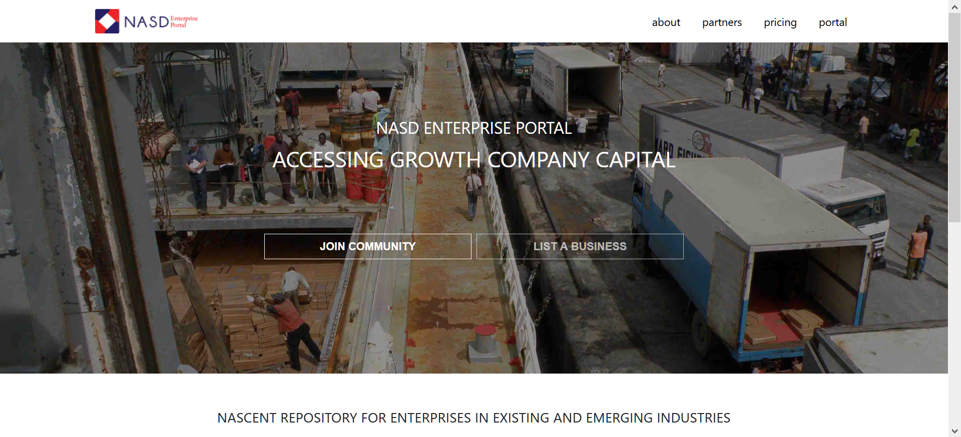
NASD Enterprise Portal
Official Launch was on Monday 16 April, 2018
Current Status
Commenced registration of Due Diligence Advisers and Accredited Investors (PE)
MOUs have been signed with strategic partners and feeder groups
Commenced roadshow with growth enterprises through Knowledge sharing sessions and Investor Readiness Workshops

