Slide 1

2018 CAPITAL MARKET COMMITTEE MEETING
NON-INTEREST CAPITAL MARKET SUB-COMMITTEE Update

Slide 2
Objectives
1
Identify ways of using Non-Interest capital market products e.g. (Sukuk) as a tool for financing infrastructural development
2
Identify the regulatory issues that may impede the development of the non-interest capital market including tax, liquidity and pension investment
3
Identify ways for using NICM as an instrument of financial inclusion and deepening the market

Slide 3
RECENT DEVELOPMENTS FROM LAST CMC MEETING
Debt Management Office issued a Sovereign Sukuk of NGN 100 billion
Securities and Exchange Commission approved sukuk listing rules for the FMDQ
Sukuk listed on the official daily list of the Nigeria Stock Exchange and FMDQ OTC
CBN issued guidelines for the grant of liquidity status for State Government Sukuk
CBN accord liquidity status to FGN Sukuk
FIRS issued tax neutrality letter for FGN sukuk
PENCOM updated its rules to allow non-interest instruments as an allowable asset class for PFAs

Slide 4
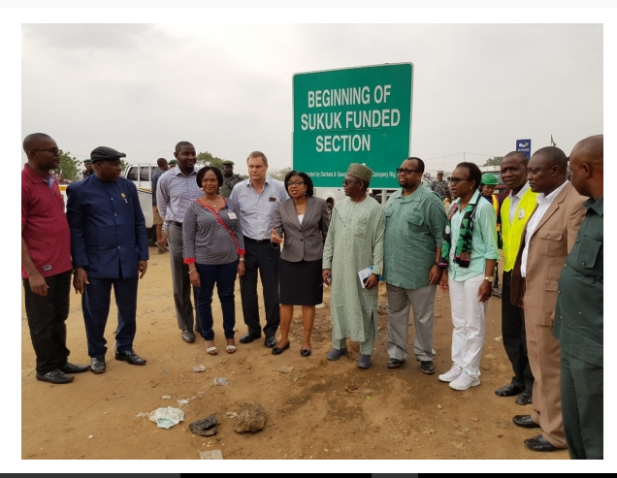
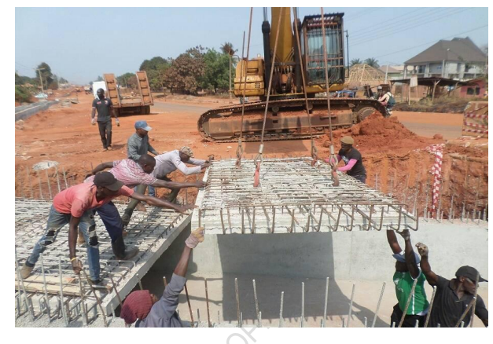
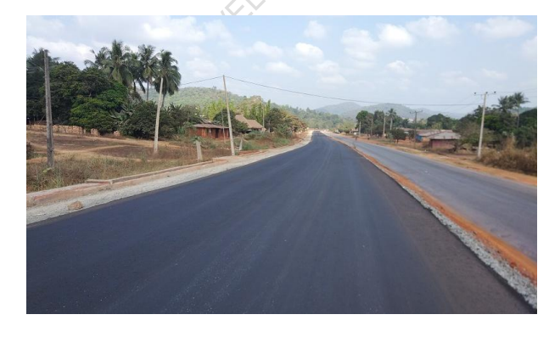
FACTORS RESPONSIBLE FOR DEVELOPMENTS
FGN Sukuk
Infrastructure-tied
National development
Financial inclusion
Low entry level investment
Some of the sukuk projects under construction
Utilisation verification by the DMO

Slide 5
FACTORS RESPONSIBLE FOR DEVELOPMENTS
Leadership of SEC & CMC
Engagement of key stakeholders such as FIRS, PENCOM, DMO, CBN etc through the Capital Market Masterplan Implementation Council (CAMMIC)
Monitoring through the accountability framework of CMC

Slide 6
CHALLENGES / NEXT STEP
Release of general tax guidelines clarifying tax neutrality of non-interest transactions by FIRS
Work with supra national entities such as AFC, IFC,ADB to include sukuk options in their capital plans
Work with state governments and capital raising MDAs such as Federal Mortgage Bank and the NMRC to explore sukuk options
Commitment by fiscal authorities to allocate at least 10% -20% of capex to sukuk annually
Work with the SEC and other stakeholders to create awareness
Issuance of sukuk-backed treasury bills by CBN to create liquidity instruments for non-interest banks

Slide 7
ISSUES FOR CMC DELIBRATION
Release of non-interest transaction guidelines by FIRS
Issuance of non-interest T-bills by CBN

