Slide 1
Progress Report and Update on CAMMIC Working Group on Issuances/Listings Processes August 2018
Technical Committee on Attraction of New Listings

Slide 2
Working Group on Issuances/Listings Process
Mandate
Status
To urgently carry on with the stakeholder meeting as planned and lead all necessary engagements and actions; | Done
Critically examine challenges with existing issuance/listings process and quick time to market of registrable securities; | Done
Propose measures to streamline current framework; | Done
Produce a report on the subject to be presented at the next CAMMIC Meeting in August 2018 | Done

Slide 3
Challenges with Existing Issuance/Listings Process
Quality of Filing
Certification of Documents at CAC
Vague Regulatory Requirements
Outdated Status of Capital Market Operators
Manual Process of Filing with the Regulator;
Consent Letters;
Duplication of Requirements
Image Source: Presentation on Streamlining of Bonds Issuances and Listings Processes in the Nigerian Debt Capital Markets – Emmanuel Etaderhi – May 23, 2018

Slide 4
Proposed Measures to Streamline the Current Framework
Regulator to revert on completeness or otherwise of a filing within 48hrs
Streamlining of Documentation Requirements
Adoption of Limited Role in Bond Transactions by the Regulator
Filing of Consent Letters with executed offer documents
Framework to accommodate emerging market trends
Introduction of Framework on Electronic Filing
Regulator to engage CAC on online verification of corporate documents
Institutionalized Training of operators by Regulator & Exchanges
Introduction of Checklists, Templates and Interpretative Guides
Regular updates on the status of Capital Market Operators

Slide 5
Action Points
To provide Templates for Common Documents, e.g Consent Letters, declarations, etc. | SEC (AIHN to provide a list of required templates)
To provide a checklist of requirements (which includes a check box) for Issuers and Issuing Houses to attach to submissions. | SEC
To provide regular updates on the SEC website regarding status of Capital Market Operators. | SEC
To institutionalize comprehensive training for Capital Market Operators | SEC and Exchanges
To provide Interpretative Guidance | SEC
To Consider feasibility of having consent letters filed at the point of filing executed offer documents with the Commission | SEC
To liaise with CAC on the reliability of the online portal for verification of corporate documents and information on potential issuers | SEC

Slide 6
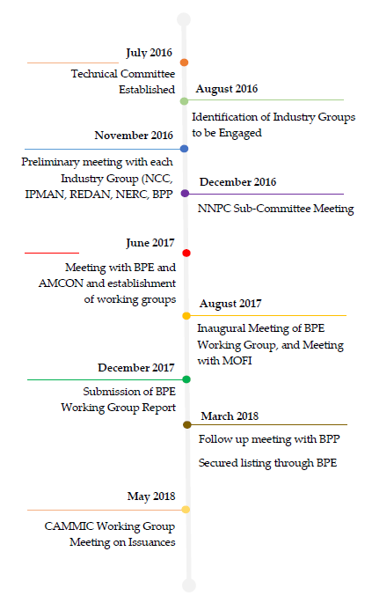
Progress Report – Technical Committee on Attraction of Listings
Industry Engagement
Regulator Engagement
MDA Engagement
Next Step- Submission of Final Report at the Next CMC

Slide 7
THANK YOU!
Any questions?

