Slide 1
RECENT DEVELOPMENT FROM THE LAST CMC MEETING
The Committee has since concluded and submitted its report to the Commission.
The report overs, among others:
Importance of developing the commodities market and composition of the ecosystem
– identified about 20 benefits of a thriving commodities market
Evolution of commodity trading markets
– global, continental and Nigeria ( zeroing on where we are now).
Current structure of the commodities market
– direct and active players, supporting ministries and institutions, service providers and interrelationship among the institutions.
Building blocks for the development of the commodities market.
Commodities exchange participants.
Organizing small holders farmers into cooperatives
- facilitate access to finance and inputs,
- promote produce aggregation
- better product pricing, etc
Recommendations and timelines

Slide 2
THE BUILDING BLOCKS
Large demand and liquidity
Existence of commodities to form nucleus of trading
Price transparency (real time info on price, volume and quality)
Good enabling business environment.
Efficient standard and grading system
Efficient trading system
Strong risk management mechanism
Sound legal and regulatory environment
Clearing, settlement and delivery system (clearing house a must for derivatives)
Good network and quality of physical infrastructure
Variety of commodity market participants- operators, hedgers, speculators etc
Collateral management services
Efficient logistic services and warehouses
Organizing small holder farmer
Capacity building and public awareness
Derived value in using the market

Slide 3
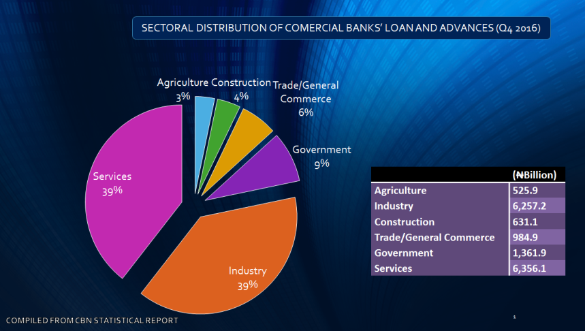
GLOBAL COMPETITIVENESS OF NIGERIA AND SECTORAL DISTRIBUTION OF COMMERCIAL BANK LOANS

Slide 4
RECOMMENDATIONS AND TIMELINE FOR IMPLEMENTATION
Phase I (Year 1-2) 2018-2019
Objective: Food/inputs sufficiency, price discovery and market development
Market type: Cash-spot
Commodities: Agriculture - Maize, Sorghum, soybeans, Cassava and Rice
Phase II (Year 3-4) 2020-2021
Objective: Export-focus commodities
Market type: Cash, forwards and futures
Commodities: Agriculture - Cocoa, Sesame, Cotton and Oil Palm
Phase III (Year 5-6) 2022-2023
Objective: Risk management products
Market type: Cash and Derivatives
Commodities: Futures, swaps and options in agriculture and solid minerals
Phase V (Year 7-8) 2024-2025
Objective: Strong International Presence
Market type: Cash and Derivatives
Commodities: Agriculture, Solid Minerals, Energy etc.

Slide 5
RECOMMENDATIONS AND TIMELINE FOR IMPLEMENTATION
Phases | S/N | Requirements/Recommendations | Actions by
Phase 1 | 1 | Develop a public enlightenment/education roadmap for commodities market | SEC
 | 2 | Organize international conference on development of a thriving commodities ecosystem in Nigeria (1st half, 2018) | SEC, Relevant stakeholders
 | 3 | Encourage investment in warehouses and storage facilities by exchanges/private sectors | Exchanges and Private Sectors
 | 4 | Allow exchanges to own warehouses at this developmental stage. | SEC and Exchanges
 | 5 | Encourage existing commodity merchants such as Olam and New Nigerian Commodity Marketing Company to participate actively on the exchanges either as traders or investors | SEC and Exchanges
 | 6 | Commodity exchanges to provide commodity price information via information centers, media, website and mobile phones (Ethiopia and Kenya model) to farmers and stakeholders across the country | FMARD and Exchanges
 | 7 | Organize farmers into cooperatives to aggregate produce and encourage them to become members of exchange | CBN (FSS 2020), SEC, Exchanges FMARD and relevant stake ministries
 | 8 | Partner with NBS on price information | NBS, SEC and Exchanges
 | 9 | Commence advocacy for macroeconomic stability and policies which will promote the commodity market (exchange rate, interest rate, inflation rate, infrastructure etc.) | CAMMIC
 | 10 | Commence advocacy for amendment of the Land Use Act | NEC, CAMMIC, NASS, CBN (FSS 2020)
 | 11 | Engage with Governors’ forum to encourage delegation of land matters to relevant agencies | CAMMIC, CBN (FSS 2020)
 | 12 | Review SEC rules and regulations relating to commodity exchanges especially for the spot market | SEC and Exchange
 | 13 | Develop rules on collateral management | SEC
 | 14 | License collateral managers/management companies | SEC and Exchanges
 | 15 | Introduce Electronic Warehouse Receipt (EWRs) | Exchanges
 | 16 | Government to patronize the exchanges for purchases in respect of strategic grain reserves, emergency feeding programme, e.g. IDP; and MDAs | CAMMIC
 | 17 | Encourage government contractors to buy commodities of a certain volume from commodity exchanges | CAMMIC
 | 18 | Encourage International organizations such as the World Food Programme (WFP)to patronize the exchanges for some of their requirements | CAMMIC
 | 19 | Review Nigerian Bankruptcy Law to promote the derivatives market | CAMMIC, and Exchanges
 | 20 | Establishment of Central Counterparty (CCP) | Exchanges

Slide 6
RECOMMENDATIONS AND TIMELINE FOR IMPLEMENTATION
Phase 1 (Continued) | 21 | Review downwards minimum capital requirement for spot market participants | SEC
 | 22 | Introduce risk based capital requirement for commodities operators for non-spot commodities traders | SEC
 | 23 | Delegate regulation of operators in the spot market to Exchanges | SEC
 | 24 | Expedite the enactment of a warehouse receipt bill into law. Also, the SEC should have regulatory purview over warehouse/storage facilities for exchange traded commodities as against the proposed warehouse regulator as contained in the bill before the National Assembly | CAMMIC, CBN (FSS 2020), NASS
 | 25 | Develop grading and standardization system in line international best practices | SON, SEC, CBN and Exchanges
 | 26 | Increase the capacity of IST to handle commodities exchange related disputes | IST, SEC, Exchanges
 | 27 | Develop a certification system for collateral managers in Nigeria through collaboration with international development agencies and international certifications bodies | SEC, Exchanges
 | 28 | Strengthen the commodities exchange unit of the SEC to discharge it functions effectively | SEC
 | 29 | The Bank of Agriculture (BOA) should be more more efficient and relevant to the Commodity trading ecosystem, which could include partial privatization of the institution | CAMMIC
 | 30 | Engage with transporters to enlighten them on opportunities available for haulage of exchange traded commodities | Exchanges
Phase 2 | 1 | Review foreclosure law to eliminate the challenge of possession in defaults and thereby promote access to finance | CAMMIC, NASS
 | 2 | Amend the Land Use Act | NEC, CAMMIC, NASS, CBN (FSS 2020)
 | 3 | Continuous de-risking of the agricultural value chain | NAICOM, NIRSAL, NAIC, Insurance Companies, BOA
 | 4 | Designate high value export commodities such as cocoa as flagship products and incentivize trading through exchanges | CAMMIC, NEC, CBN (FSS 2020)
 | 5 | Exchanges should install traceability system for Nigeria’s flagship and other export commodities that are traded through their platform | Exchanges
Phase 3 | 1 | Exchanges should key into the Customs Single Window System to ease the process of export | Exchanges
 | 2 | Work with Ministry of Mines and Steel Development and Ministry of Petroleum to introduce energy and solid minerals on the exchanges | Ministry of Mines and Steel Development, Ministry of Petroleum, Exchanges
Phase 4 | 1 | Introduce solid minerals on the commodity exchange | Ministry of Mines and Steel Development, Exchanges
 | 2 | Introduce energy, e.g. crude oil on the commodity exchange | Ministry of Petroleum, NNPC, Commodity Exchanges
 | 3 | Attract international players to trade on the exchange | SEC, Exchanges
 | 4 | Warehouses to be independent of a commodity exchange | SEC

