Slide 1
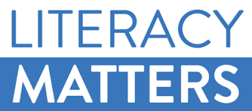
Update
on
Financial Literacy Technical Committee
@
First CMC Meeting in 2019

Slide 2
Half year 2017
Major Progress since Last Meeting
Supervised alongside the SEC, two successful workshops – Planning/Writing & Critique/Editorial workshops on the development of a stand-alone capital market studies curriculum for basic and secondary schools in Nigeria.
Uploaded fresh video on financial literacy on our You Tube page
A total sum of Eleven Million, Six Hundred and Thirty Nine Thousand (N11,639,000) was expended on organizing both workshops
The Committee was represented at the town hall meeting on current initiatives by the SEC to enhance investor value, at Enugu state.

Slide 3
Half year 2017
Success Factors
Inspiring leadership by SEC - Appreciated
Fund already contributed by some of our fellow stakeholders is being put to judicious use – Thank you
Apparent deliverables - Encouraging
NERDC’s enthusiasm – Infectious
Encourage non-compliant stakeholders/trade groups to live up

Slide 4
Half year 2017
Challenges/Steps Taken
Funding continues to be the greatest challenge
CMC Chair earlier wrote defaulting stakeholders on the need to honour commitments.
On its part, the Committee forwarded reminders to stakeholders with outstanding balance.

Slide 5
Half year 2017
Issues for CMC Deliberation
We are appealing to all the stakeholders to honour their pledges to forestall any delay to the initiative.
Stakeholder representatives on the Committee are implored to show commitment to attendance and contributions at meetings
The next phase of the initiative is the Planning/Writing workshop for the curriculum to be infused into relevant subjects.

