Slide 1
TECHNICAL COMMITTEE ON MARKET LIQUIDITY ENHANCEMENT
Committee Presentation
November 21, 2019

Slide 2
INTRODUCTION
The overall objective of the committee is to recommend actionable steps to drive the implementation of initiatives in the Master Plan aimed at enhancing market liquidity, which is central to the consolidation of the gains from other ongoing initiatives in the Nigerian capital market
In furtherance to this objective, the technical committee's activities are expected to be guided by the broad terms of reference enumerated below:
Examine existing liquidity enhancement initiatives such as securities lending and market making to identify possible challenges and constraints;
Develop a roadmap for the enhancement of liquidity in the market; and
Undertake any other activity that may be relevant to the achievement of the mandate
The Committee operated via two (2) main sub-committees with focus on equity and fixed income
The Committee also invited and received presentation/recommendations from:
Fund managers’ association of Nigeria on the liquidity challenges facing Collective Investment Schemes
Stanbic IBTC on the challenges with the implementation of the NSE Securities Lending & Market Making Program
The Committee has now consolidated the identified challenges, recommendations and solutions into a final report.

Slide 3
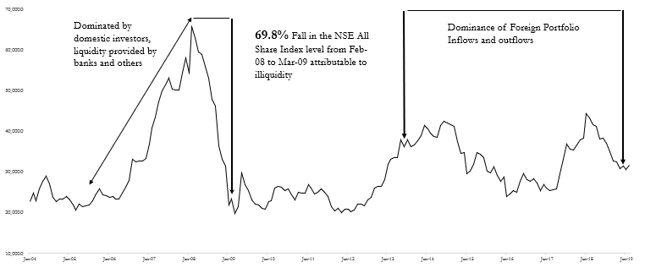
FUNDING: A CRITICAL TOOL FOR LIQUIDITY ENHANCEMENT
Assets
Liabilities?
Capital
Sources: NSE, DLM
The rise (2004 - 2008) and crash (2008 - 2009) of the equities market, as indicated by the Nigerian All Share Index, coincides with the availability and withdrawal of funds via bank-based margin loans to Stockbrokers
The failure of this product – margin loans – and its impact on the market provides robust evidence that funding liquidity drives market liquidity as predicted by several research reports (see Gromb and Vayanos (2002) and Brunnermeier and Pedersen (2009))
Capital Market Operators in Nigeria are endangered species as they face significant challenges in funding their businesses and their fixed income traders trade without real-time information. They are effectively side-lined to limited brokerage only with no real added value from a liquidity standpoint
Liabilities are required to fund the institution’s creation of assets; without this, their businesses will remain very small with very little, if any, impact on the economy

Slide 4
THE ROADMAP: RECOMMENDATION TO BOOST FUNDING LIQUIDITY
The Malaysian Case Study
Enactment of CMSA 2007
Malaysia repealed the Securities Act 1983 (SIA) and the Futures Industry Act 1993 (FIA) and replaced them with The Capital Market and Services Act 2007 (CMSA) which introduced a single licensing regime for capital market intermediaries. Under this new regime, a capital market intermediary will only need one License (Capital Markets Services License) to carry on the business in any one or more regulated activities. This gave rise to stronger institutions; also meant less cost and paperwork for the intermediaries who carry on more than one regulated activity
Universal Broker Licensing
A joint action of Bank Negra Malaysia and the Securities Commission licensed universal brokers who were subject to certain eligibility criteria. The move, which allowed qualified brokers to access the interbank market to both borrow and lend, was aimed towards enhancing the capacity and capabilities of domestic capital market intermediaries to contribute towards the development of a more resilient, competitive and dynamic financial system
In the Nigerian Financial Markets today, only bank-based intermediation works efficiently. Market-based intermediation is much less efficient as operators, especially those of the capital markets, face significant challenges accessing wide sources of funding. They have very inefficient sales and trading operations and are unable to contribute meaningfully to the liquidity of the capital markets. Therefore, it is recommended that the SEC pursues granting qualified Capital Market Operators access to wholesale funding which is a sine qua non to diversifying intermediation channels

Slide 5
THE ROADMAP: CURRENT REFORMS
Equities Market Making
Equities Securities Lending
Restructuring Equities Margin Trading
Exchange-Traded Repurchase Agreement
Promote Retail Participation
via CIS
Market Education
/ Investor
Awareness
The above contains some of the critical ongoing reforms in different segments of the Capital Market. These will ensure the survival of Capital Market Operators, boost liquidity in the short to medium term and crucially lay the foundation for qualified CMOs to take advantage of the primary recommendation of the report – structural diversification of intermediation channels.

Slide 6
OPPORTUNITY FOR REGULATORY ADVOCACY
While capital market stakeholders must work towards the advancement of the market, government regulations and policies remain crucial to the development of any market. We, therefore, recommend the SEC’s advocacy / actions on the following items:
Reduction / Elimination of capital controls
Effective Fiscal
and
Monetary Policy
Banks’
collaboration with Brokerage Firms
for distribution
Provision of Tax Incentives
Clarify Pass- Through Status of CISs
Improve Financial Market Integrity
Privatisation
of SOEs via Capital Raising Activities in the Public Market
Promote Transparency & Comparability of CISs

Slide 7
THANK YOU

