Slide 1
2020 CAPITAL MARKET COMMITTEE (WEBINAR) MEETING Thursday, 20th August, 2020
PRESENTATION BY e-dividend committee

Slide 2
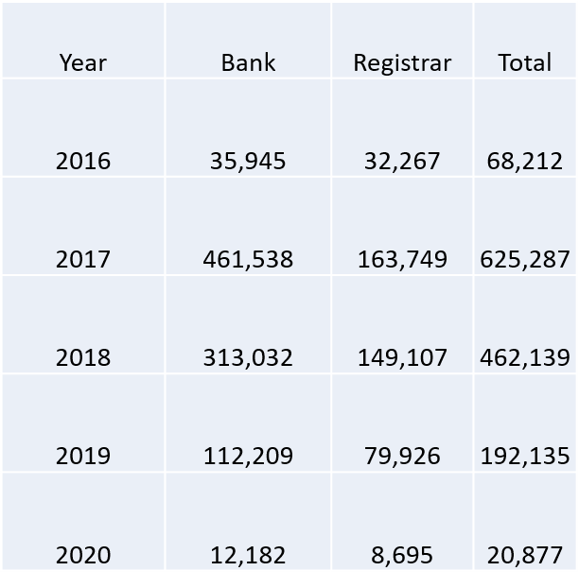
MAJOR PROGRESS SINCE THE LAST CMC MEETING
As at March 2020, about 1,368,650 accounts have been mandated.
The breakdown of mandated accounts is shown below:

Slide 3
STEPS TAKEN
The Committee met on Tuesday, 10th March, 2020 and considered the e-dividend enrolment statistics as presented by NIBSS.
Members expressed concern for the declining trend in the mandated accounts across the years. For instance, the figures kept declining from 625,287 in 2017 to 462,139 in 2018 and, 192,135 in 2019.
The Committee also deliberated on the following key issues:
The need to identify verifiable means of measuring the progress achieved by eDMMS with regards to unclaimed dividends;
The need for Age Analysis of the unclaimed dividends;
The need for continuous enlightenment campaigns due to the increasing numbers of unclaimed dividends.

Slide 4
STEPS TAKEN Cont’d
Many banks were yet to migrate to the EDMMS automated debit system for the e-Dividend Mandate Management process.
The need for cooperation between CSCS and NIBSS on information validation.

Slide 5
RESOLUTIONS
The committee resolved as follows:
That no new subscriptions should be allowed in the secondary market without full investor information;
Registrars were asked to provide data on Declared Dividends of top three (3) Companies in their records as at the date such dividends were declared and a progression analysis of the declared dividends after 1month, 6 months and 1 year. This information is required for each of the top three companies for the past 5 years.
In addition to the (2) above, Registrars were also required to provide an age analysis of their entire unclaimed dividends in the following order: 6 months and below,1 year, 2 years and 3 years & above.
It was agreed that Registrars should amend their eDMMS application forms to include the following statement: “This service costs N150 per form exclusive of VAT”.
SEC to engage CBN to give NIBSS approval on information validation cooperation with CSCS; this would be done after SEC engagement with the CSCS;
Future enlightenment campaigns should be more strategic for impact to be optimized;
The Committee’s next meeting was slated for May 12, 2020 to enable it review submissions by Registrars on e-dividend information. However, the submission by registrars and the scheduled meeting were disrupted by the COVID-19 lockdown.

Slide 6
CHALLENGES/ISSUES FOR CMC DELIBRATION
Bankers confirmation: Some registrars are still requesting for Bankers’ confirmation before agreeing to mandate their clients’ accounts, this normally comes with a cost to the investors.
Migration to Automated Debit System: Some Banks are yet to migrate to the EDMMS Automated Debit system. As at March 2020, only 7 Banks migrated.
Delays in payment of Backlogs of unclaimed dividends even after mandating investors accounts
Consequently, Investors have raised concerns around allegedly deliberate efforts by Registrars and Company Secretaries to frustrate the recovery of the unclaimed dividends and payment of subsequently declared dividends.
International clients who are yet to enrol for the Bank Verification Number (BVN) have their dividends unpaid as the search for solution continues.
Enlightenment campaigns: There is still need for enlightenment campaigns as the level of public awareness on e-dividend payment is still considered very low.

