Slide 1
Review of the Nigerian Economy and the Capital Market
Hassan H. Suleiman, Ph.D.
Economic Research & Policy Management Division,
Office of the Chief Economist, Securities and Exchange Commission, Nigeria
April 6TH , 2022

Slide 2
Outline
01
Global Economic Developments
02
Domestic Economy
03
Market Metrics
04
Outlook

Slide 3
The Global Economy (IMF, WEO-JAN 2022)
Global growth weakened (-3.1%) in 2020 due to:
Impact of COVID-19 pandemic
Disruptions in global supply chains
Falling global aggregate demand
Increasing unemployment
Rising sovereign and corporate debt
The global economy grew 5.9 percent in 2021
The International Monetary Fund (IMF)’s global growth projection is put at 4.4% in 2022.
SSA countries – had contracted at 1.7% in 2020. we expect the SSA economy to grow by 3.7% in 2022.
Nigeria – contraction in 2020 was 1.8% but is projected to grow 2.7% in 2022.
Estimate Projections
Country/Region | 2020 | 2021 | 2022 | 2023
World | -3.1 | 5.9 | 4.4 | 3.8
Advanced Eco. | -4.5 | 5.0 | 3.9 | 2.6
Euro Area | -3.4 | 5.6 | 4.0 | 2,6
EMs & Developing | -2.0 | 6.5 | 4.8 | 4,7
Sub-Sah. Africa | -1.7 | 4.0 | 3.7 | 4.0
United States | -4.5 | 5.0 | 3,9 | 2,5
United Kingdom | -9.4 | 7.2 | 4.7 | 2.3
..
China | 2.3 | 8.1 | 4.8 | 5.2
India | -7.3 | 9.0 | 9.0 | 7.1
Brazil | -3.9 | 4.7 | 0.3 | 1.6
South Africa | -6.4 | 4.6 | 1.9 | 1.4
Nigeria | -1.8 | 3.0 | 2.7 | 2.7

Slide 4
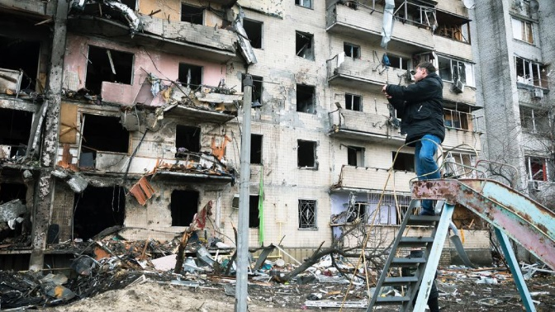
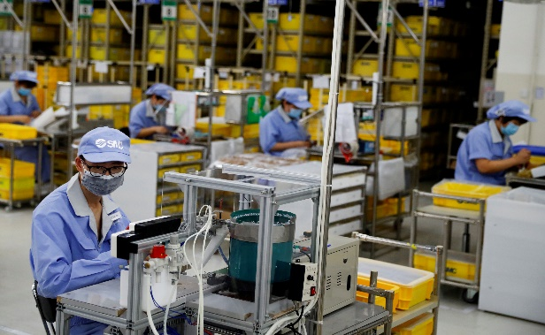
The Global Economy
The global recovery is set to decelerate markedly amid:
COVID-19 flare-ups
lingering supply bottlenecks
Falling global aggregate demand
The economic uncertainty created by the Ukraine war
UNCTAD alerts global economic growth will decrease to 2.6% from 3.6% for 2022
Global factory activity slows as Ukraine crisis, inflation bite
Three main factors are likely to take inflation higher:
energy prices
food inflation
global manufacturing bottlenecks

Slide 5
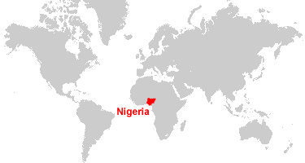
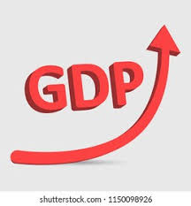
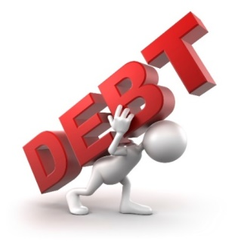
Domestic Economy
MPR
11.5%
As at April 1,, 2021
33.3%
UNEMPLOYMENT (Q4’2020)
3.4%
2021
INSECURITY
15.7%
Feb’2022
N39Trillion
As at Q4 2021
Data Source: NBS, IMF
Source: CBN
Notes:
2

Slide 6
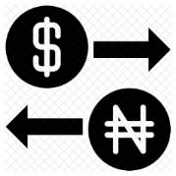
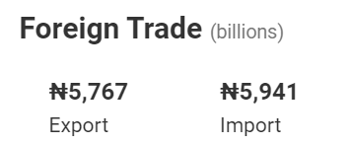
Domestic Economy
1.25 million barrels per day (BPD)
As at Feb, 2022
N416.22
$110.13
As at April 1, 2022
As at April 1, 2022
Data Source: NBS, IMF
Source: CBN

Slide 7
Capital Market Performance
January to December 2021 Primary Issuance
Net Asset Value
Issuance Type | N
Equity Issuances | 118,805,220,000.00
Debt Issuances | 476,113,000,000.00
Total | 594,918,220,000.00
S/N | Classes of Funds | Net Asset Value as at 31st December, 2021
1 | Equity Funds | 15,756,130,822.72
2 | Money Market Fund | 548,260,058,593.72
3 | Bond/Fixed Income Funds | 378,162,574,509.53
4 | Dollar Funds | 259,543,414,296.98
5 | REIT | 50,192,148,740.47
6 | Mixed | 29,348,405,683.02
7 | Ethical | 2,529,376,421.83
8 | Shari'ah Compliant Funds | 17,925,971,690.90
 | Aggregate NAV (N) | 1,301,718,080,759.17
During the year 2021, total new securities issuances amounted to N594.92billion of which N476.11billion were debt and N118.81billion were equities.
Therefore, 80.03% of issuances in the period were debt while 19.97% were equities.

Slide 8
Nigerian Capital Market Performance
Data Source: Nigerian Stock Exchange
SECURITIES AND EXCHANGE COMMISSION, NIGERIA
Notes:
The market indices were bullish in 2021 as the NGX ASI and NASD USII appreciated by 6.07% and 1.34% respectively
The S&P 500 closed December at

Slide 9
Outlook
Domestic
Heightened geopolitical tensions
Persisting macroeconomic uncertainties
Inflation
Subdued growth
Increase in crude oil price oil subsidy
Presidential race
Diminishing pandemic impacts
Global
Covid-19 still around
Technology and fintech
ESG

Slide 10
Headwinds & Tailwinds
Thank You

